Slide 1
Coke Freestyle Assignment #1: Ethnography
Louise Whitaker and Chris Roy
CIM 622: UX Research Methods
2/1/16

Slide 2
Product Research
Developed in 2009 to boost falling Coke sales
Target audience: Millennials
Has over 100 drink combinations
Uses small cartridges with flavors instead of large boxes of syrup
Design was collaboration with in-house Industrial Design Team with other companies such as Pininfarina Extra, who have done design work for Ferrari
“We’ve proven prelaunch and in-market that when a restaurant has Coca-Cola Freestyle, their traffic, incidence and beverage servings grow anywhere from single to double digits,” says Jennifer Mann, VP and general manager, Coca-Cola Freestyle.
“They expect unlimited choice, personalized and delivered through multiple channels at maximum speed,” says Joe Tripodi, Chief Marketing and Commercial Officer of The Coca-Cola Company

Slide 3
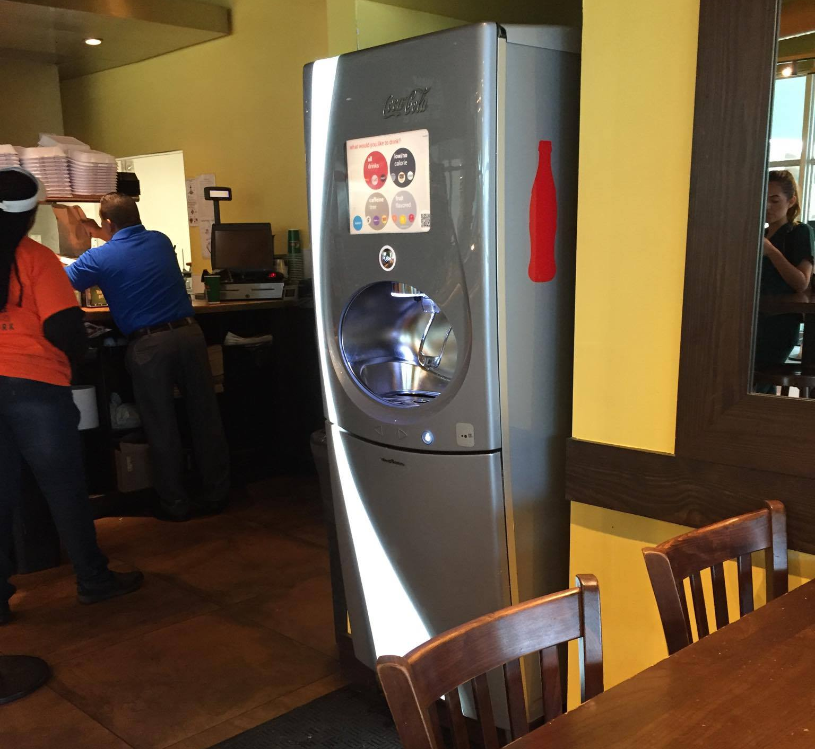
Product Description
Coke Freestyle Machines
Product Type: Touch Screen Soda Fountain
Why Selected: We selected the Coke Freestyle machine because we had used this machine before, but never spent much time thinking about all of the problems with the machine. We also wanted to be able to ask users about their experiences using the product. We did some research and found that the machine was developed in 2009 to help revitalize the soft drink industry. We wanted to see if our users were more likely to get a drink if this machine was there and if they were using the application.

Slide 4
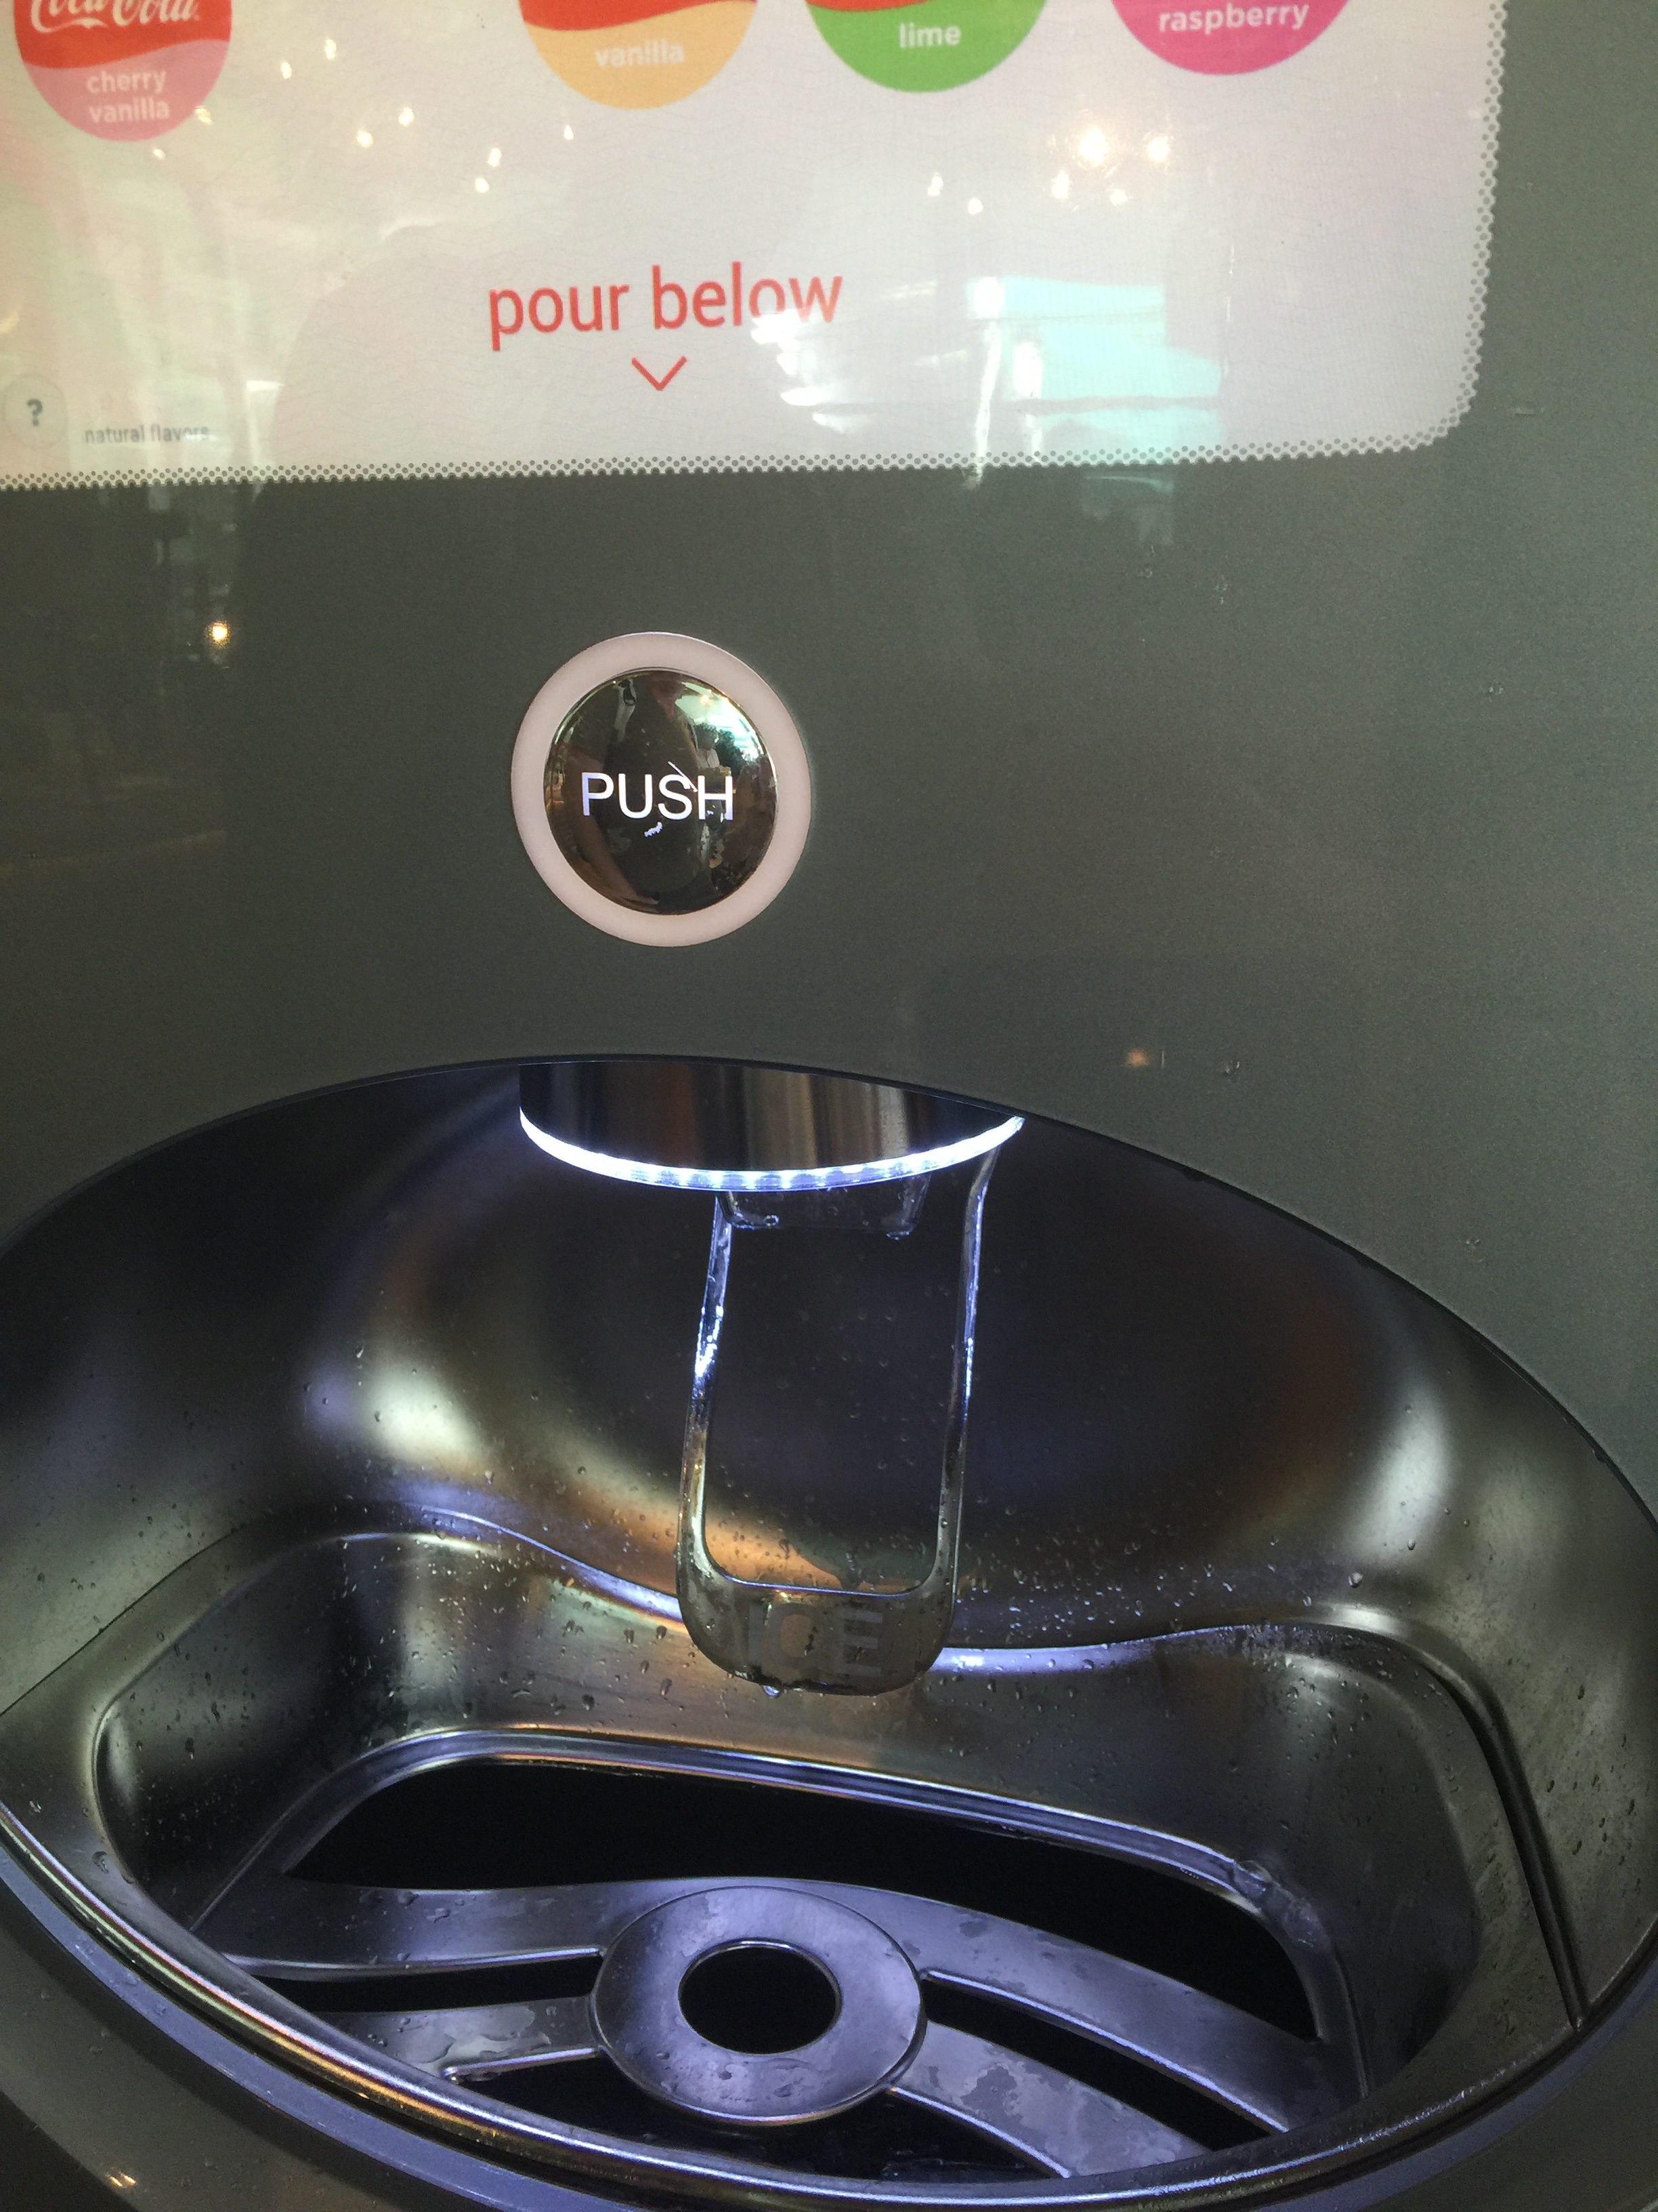
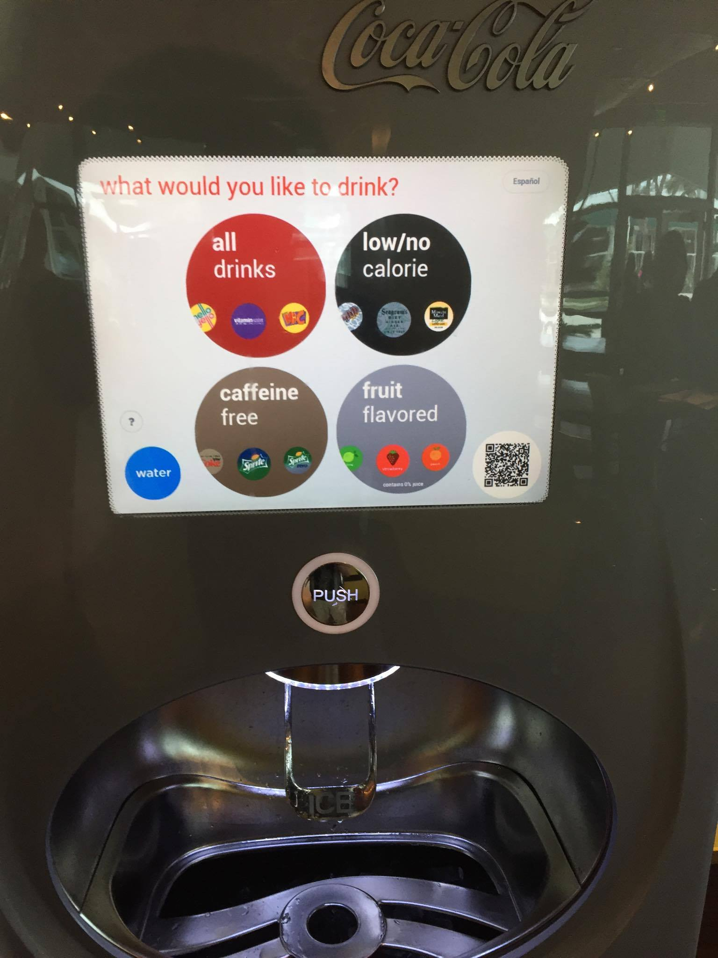
Product Description - Controls
Digital display – touch screen
“Push” button for beverage – physical control
1.
2.
Touch Screen- Main Menu
Main state of Push Button
Notes:
Controls – description
Interactions need more (how do these buttons work)
Add survey
Missing Equipment
Bettter Demographics
Break down observations more – how many people got ice
Time on task
More grnularoty of schedule
Expand on qr problems
Annotations

Slide 5
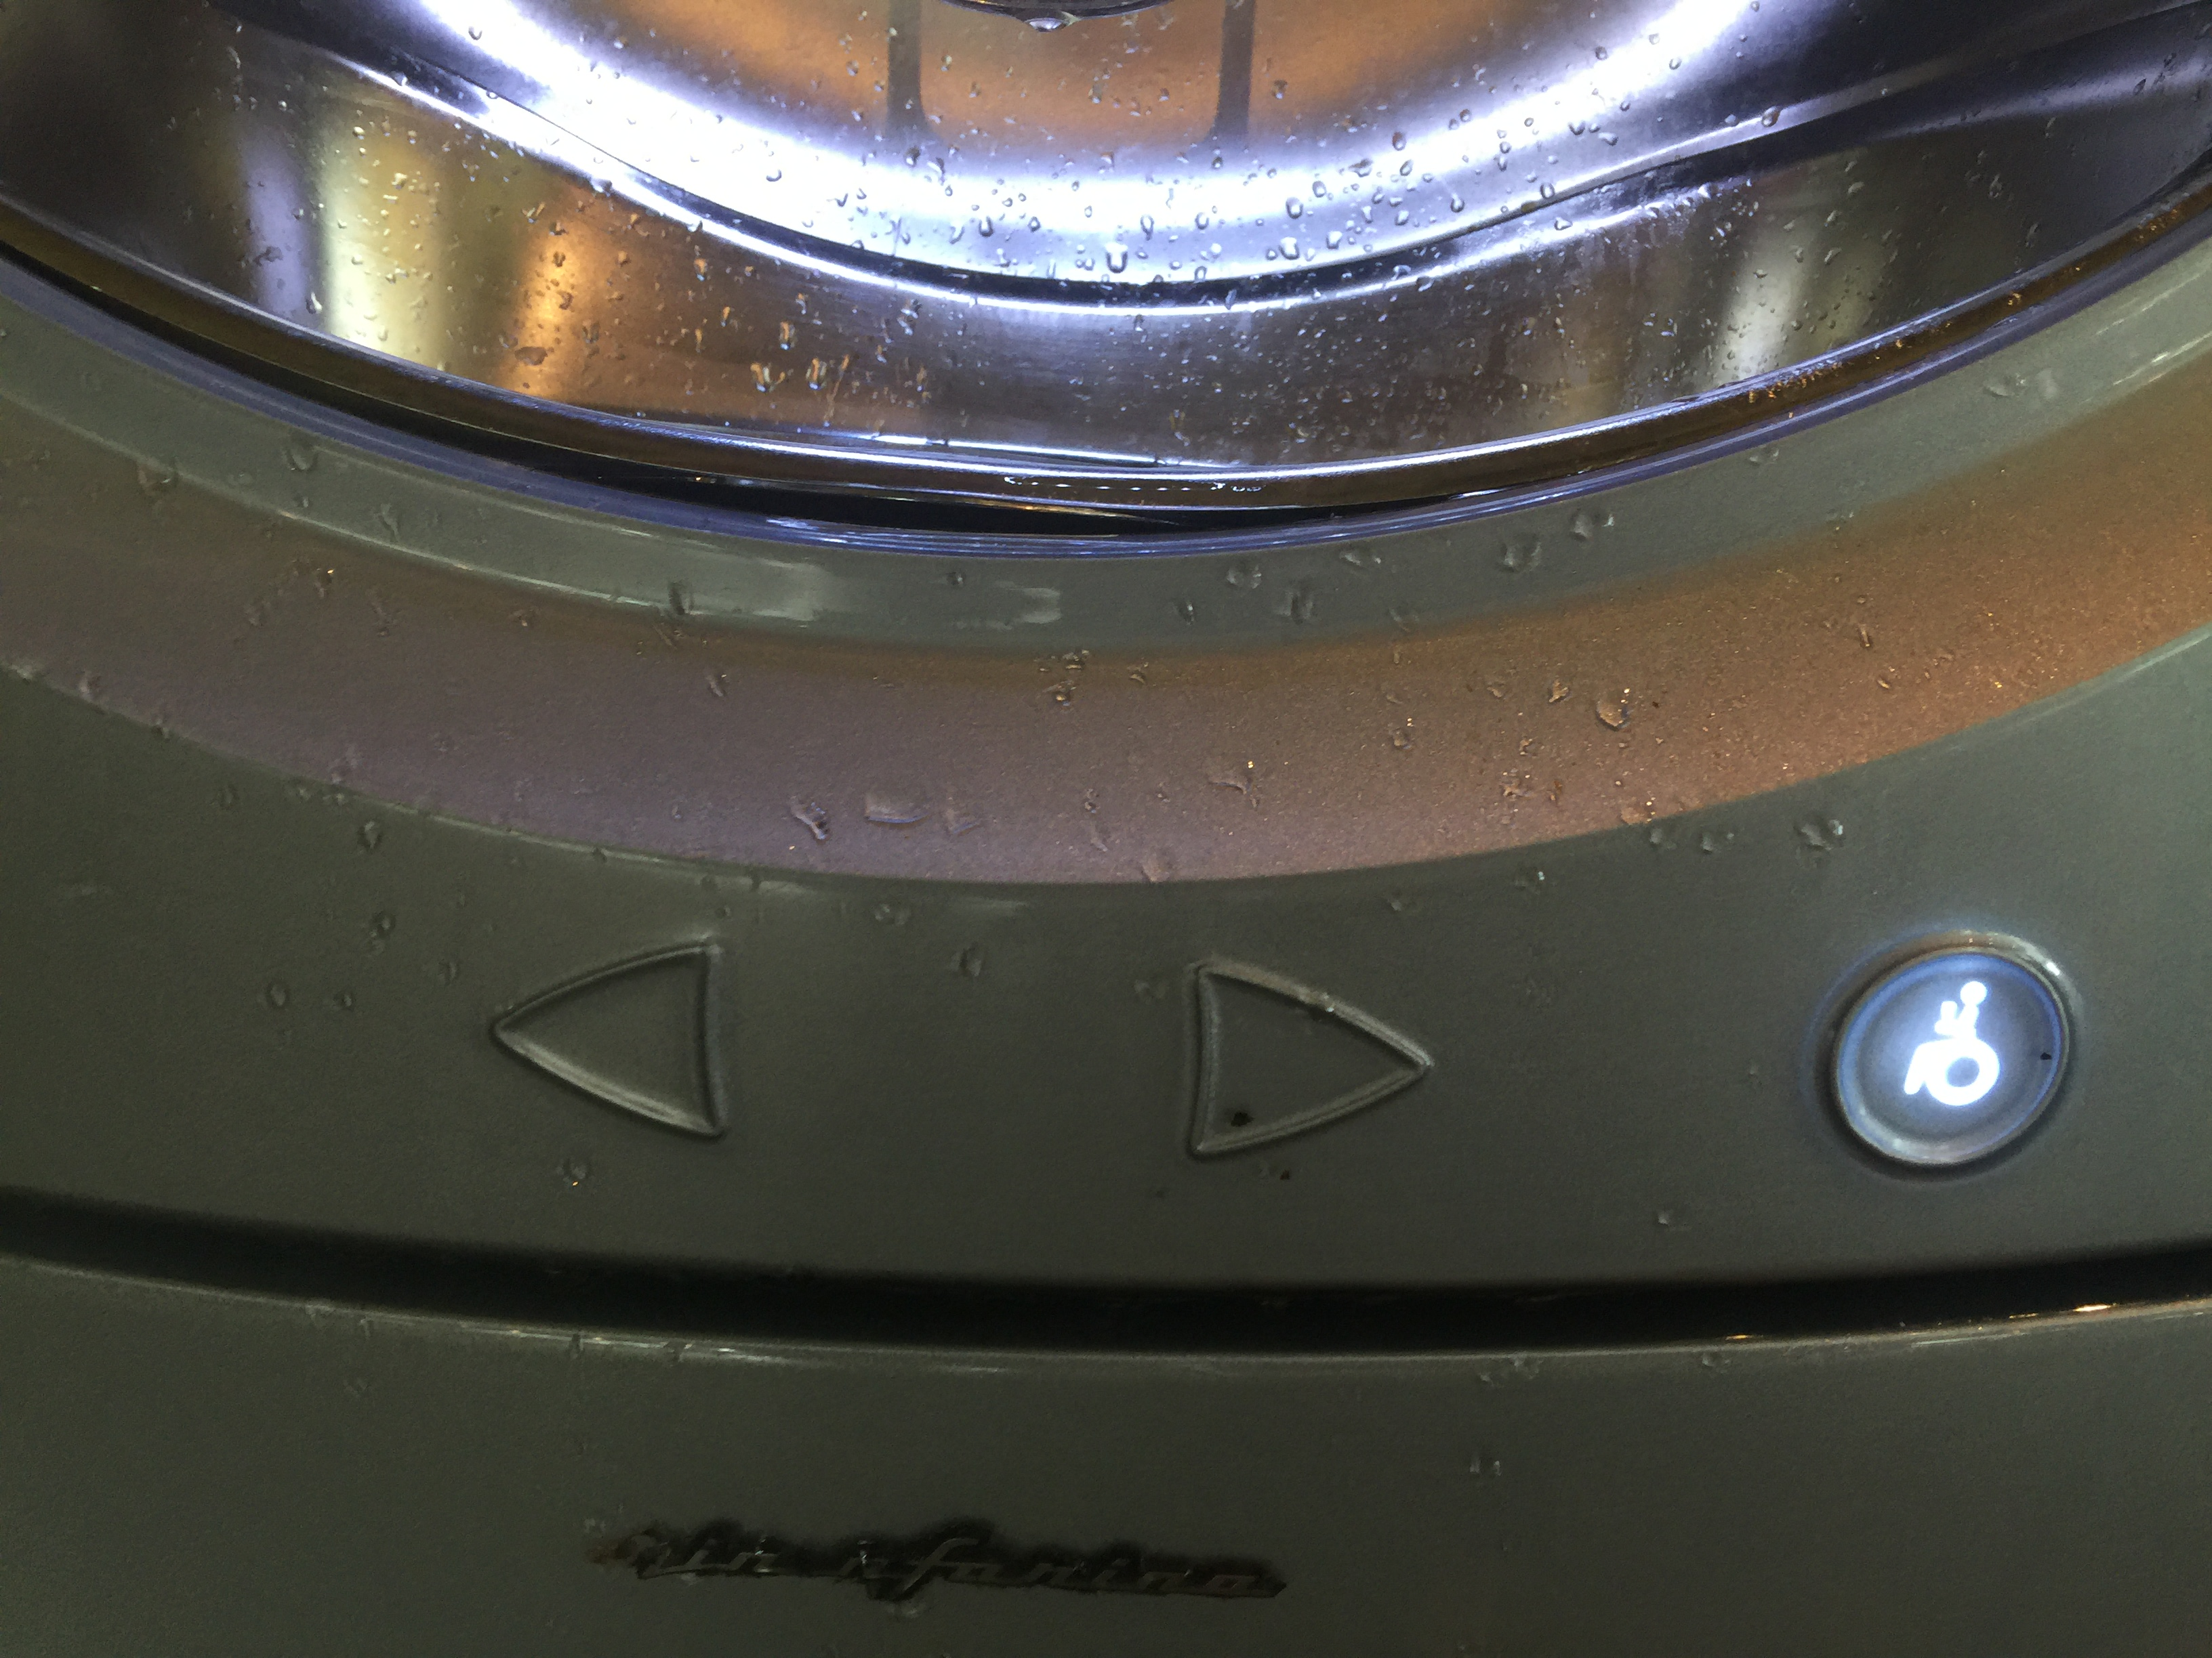
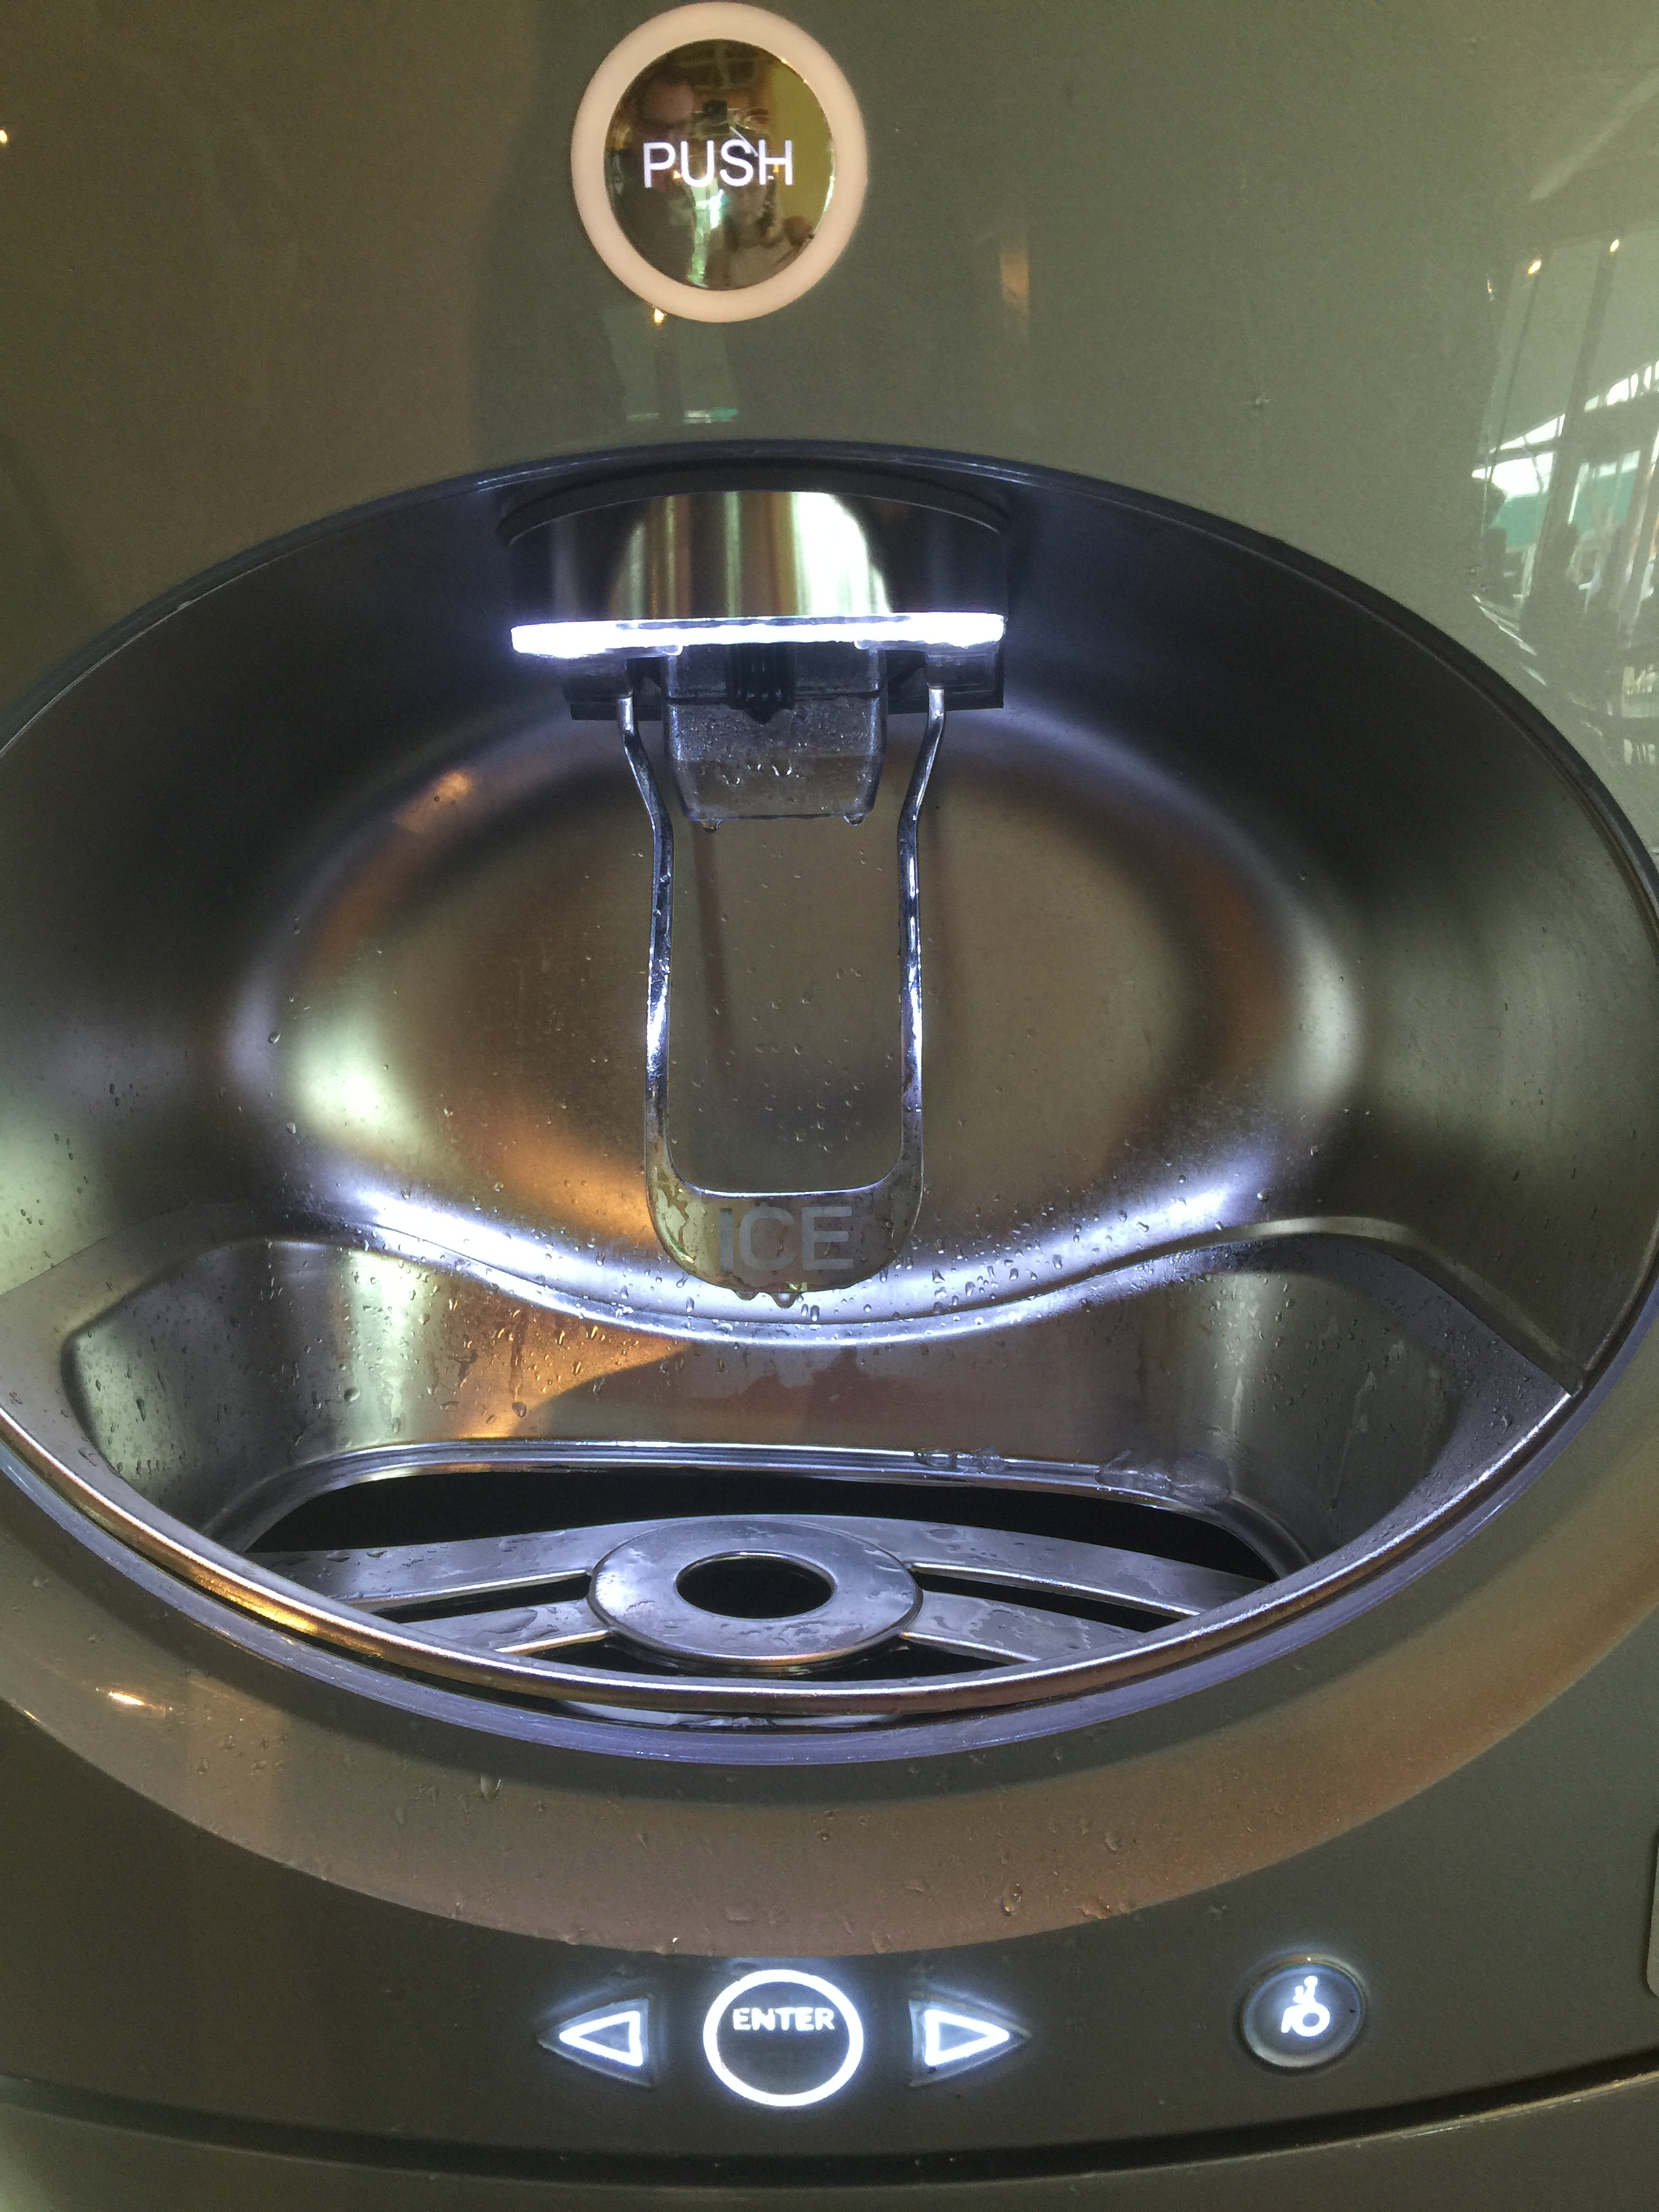
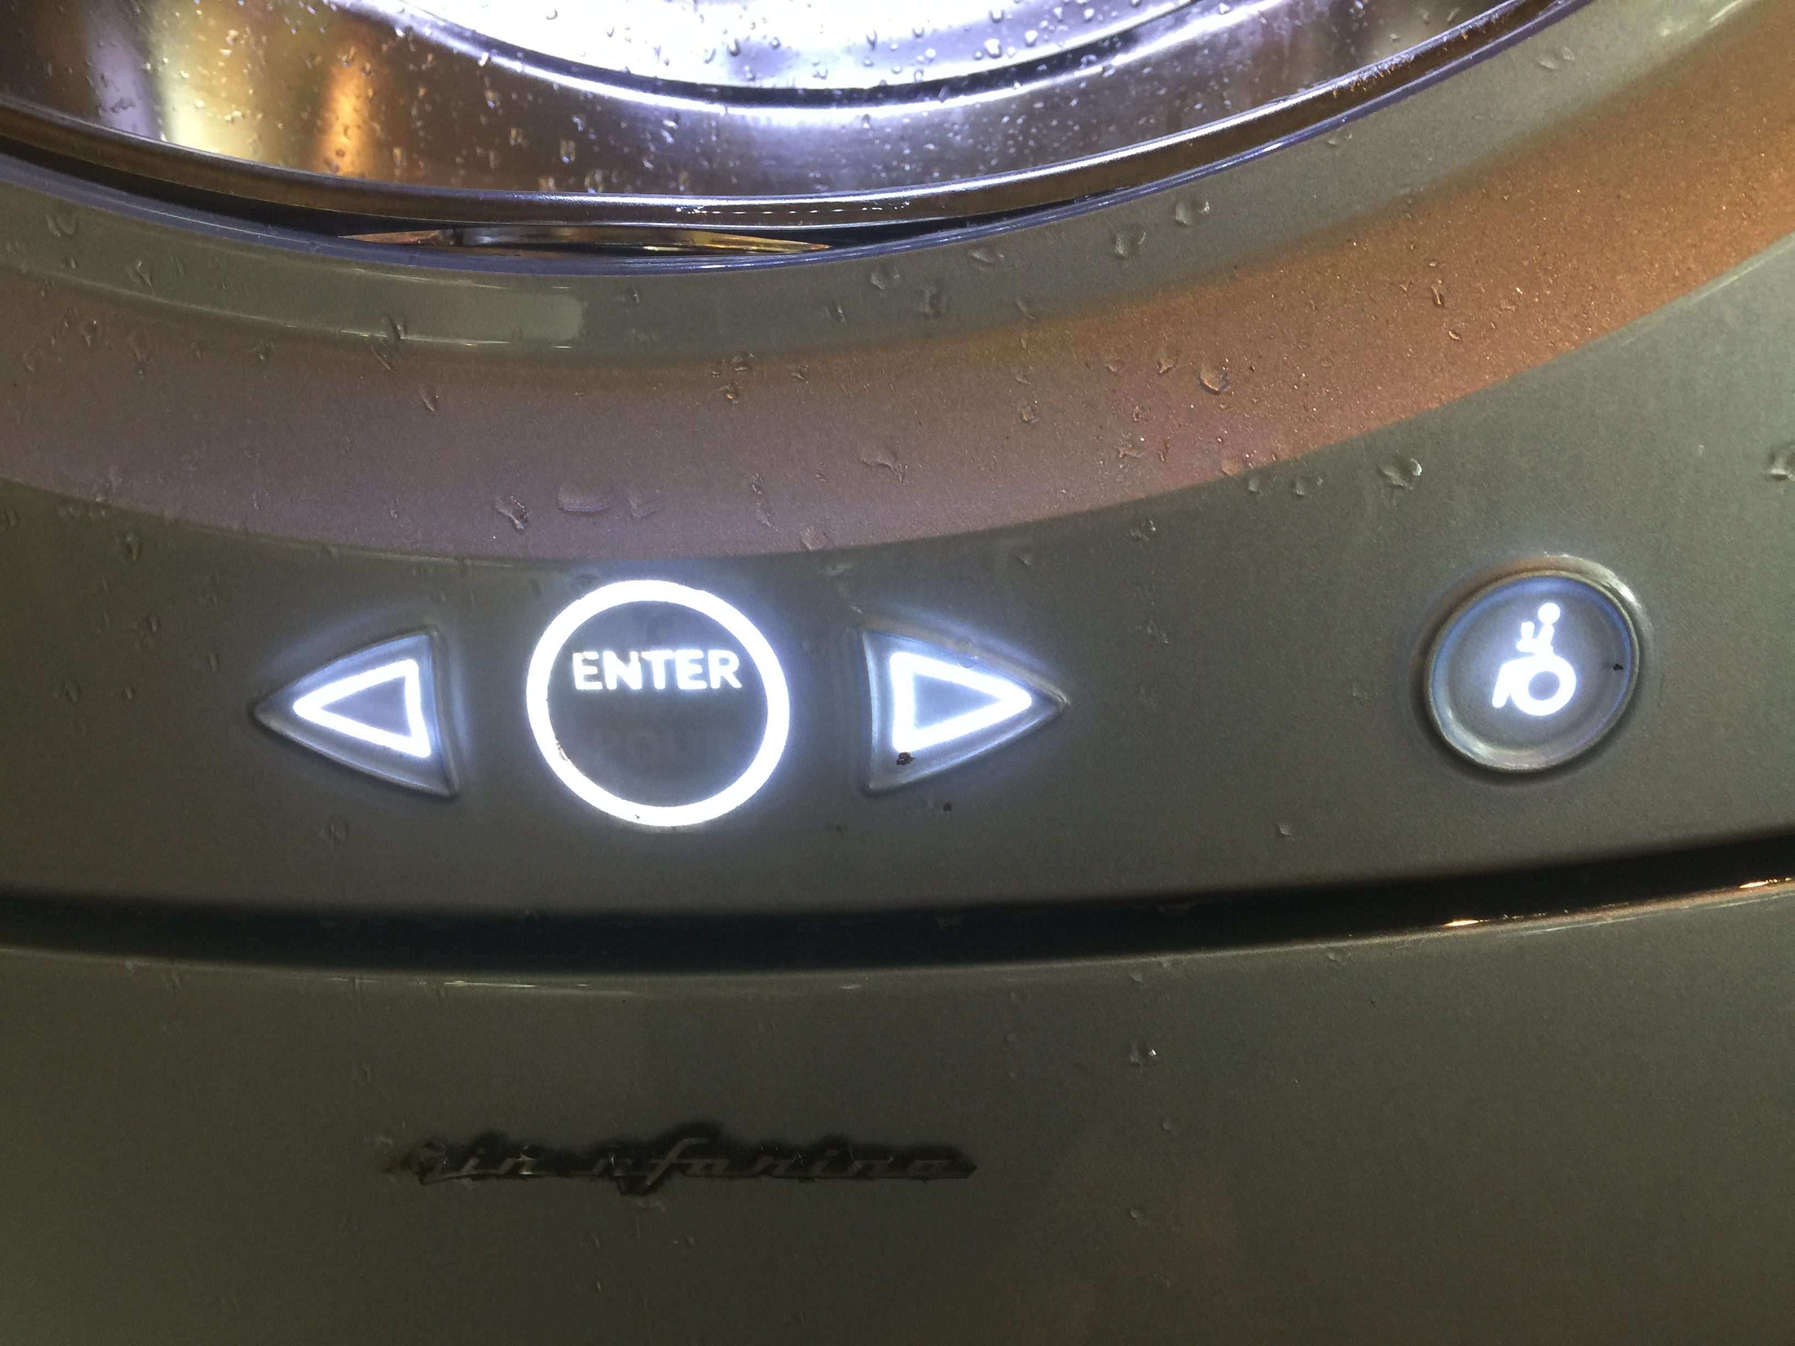
Product Description - Controls
Lever for Ice – physical control, user presses cup against lever to dispense
Accessibility buttons underneath beverage dispenser
Handicap button – physical control, button
Arrows and select button – touch button
3.
4.
Handicap button – not activated
Ice Lever
Handicap button – activated

Slide 6
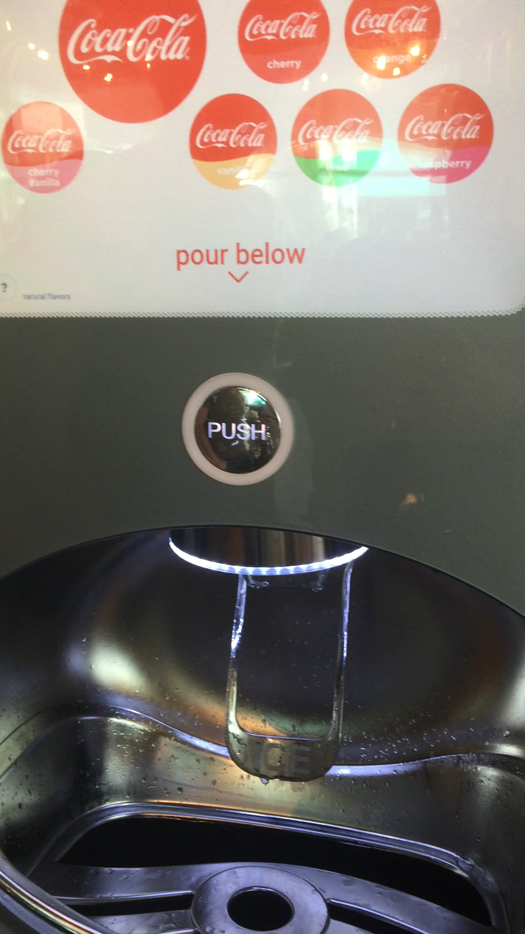
Product Description
All Interactions:
Pressing lever for ice
Pushing the button to dispense beverage, has a white light border around in, when a drink is ready to be dispensed it flashes
Selecting categories and drink icons on the machines to dispense the beverage, icons on screen expand expand when a selection is made
Pressing the handicap button, when handicap button is pressed the other three accessibility buttons light up
4.
2.
Handicap button – not activated
“Push” button Flashing
Handicap button – activated

Slide 7
Product Description
All Tasks:
Selecting a beverage
Filling cup with beverage
Filling cup with ice
Connecting phone with QR code
Notes:
Controls – description
Interactions need more (how do these buttons work)
Add survey
Missing Equipment
Bettter Demographics
Break down observations more – how many people got ice
Time on task
More grnularoty of schedule
Expand on qr problems
Annotations

Slide 8
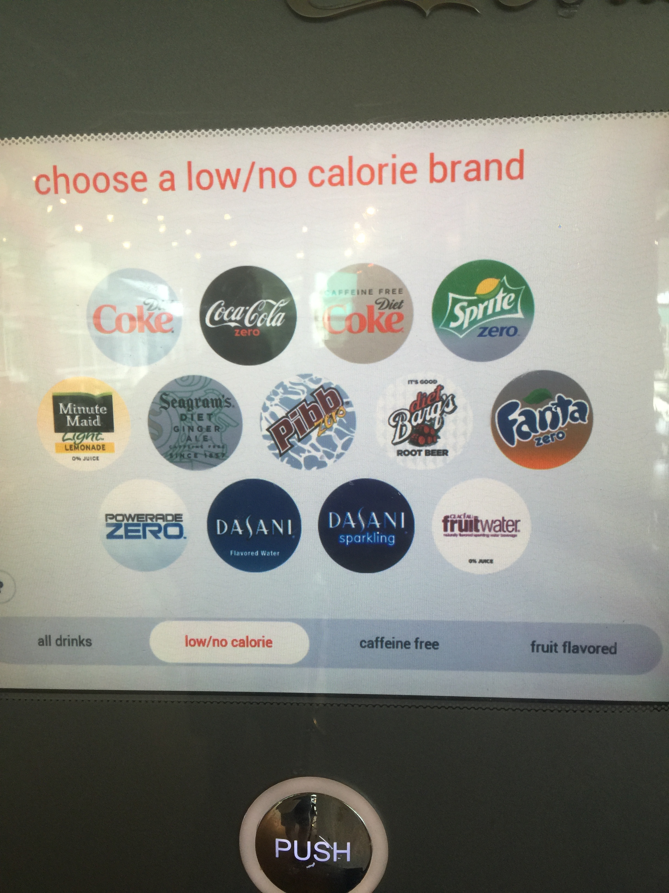
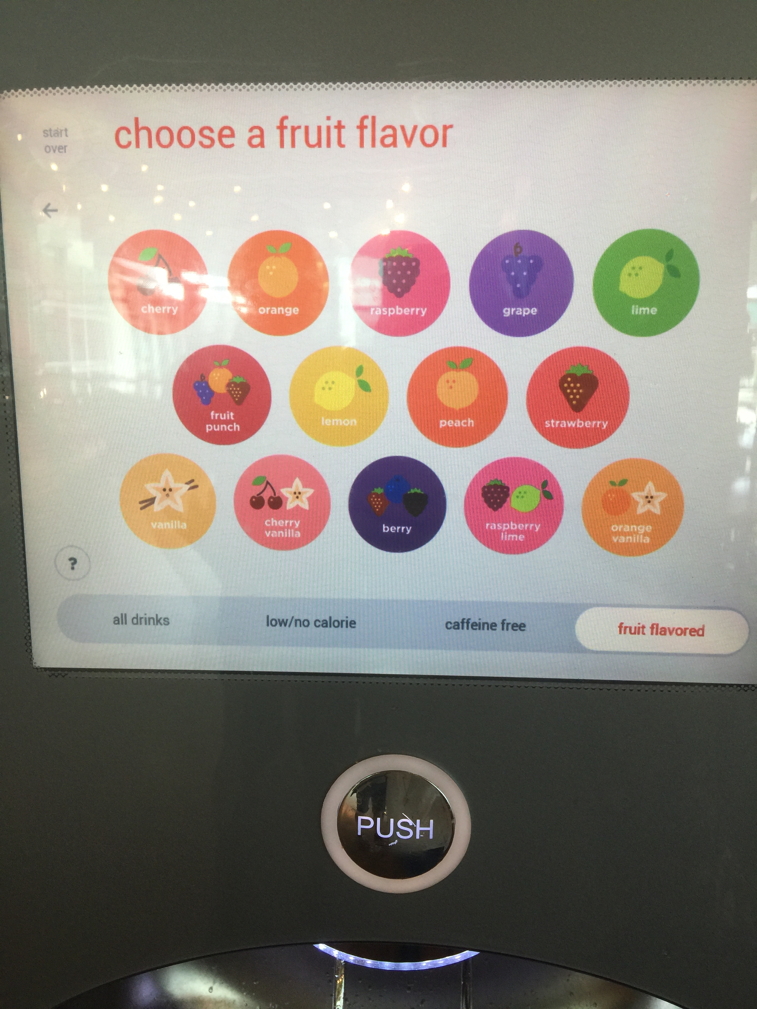
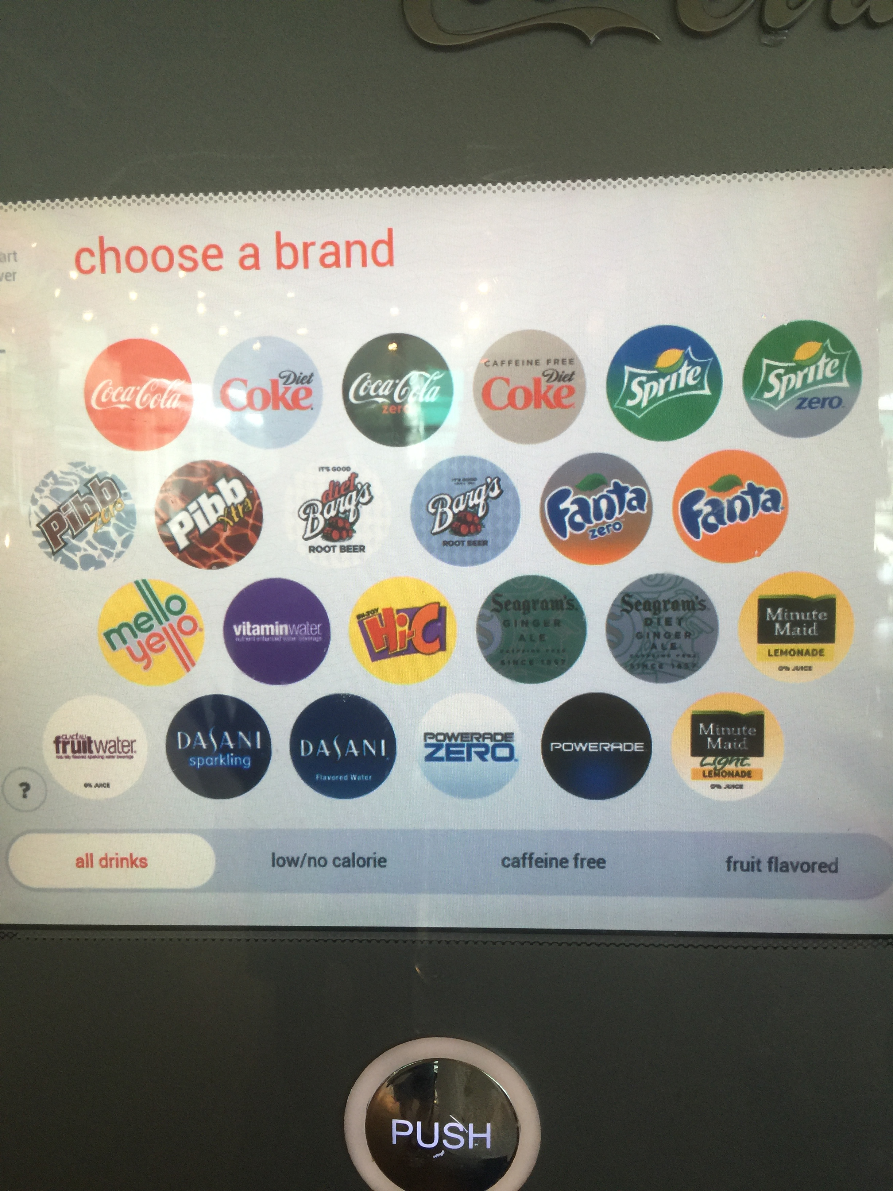
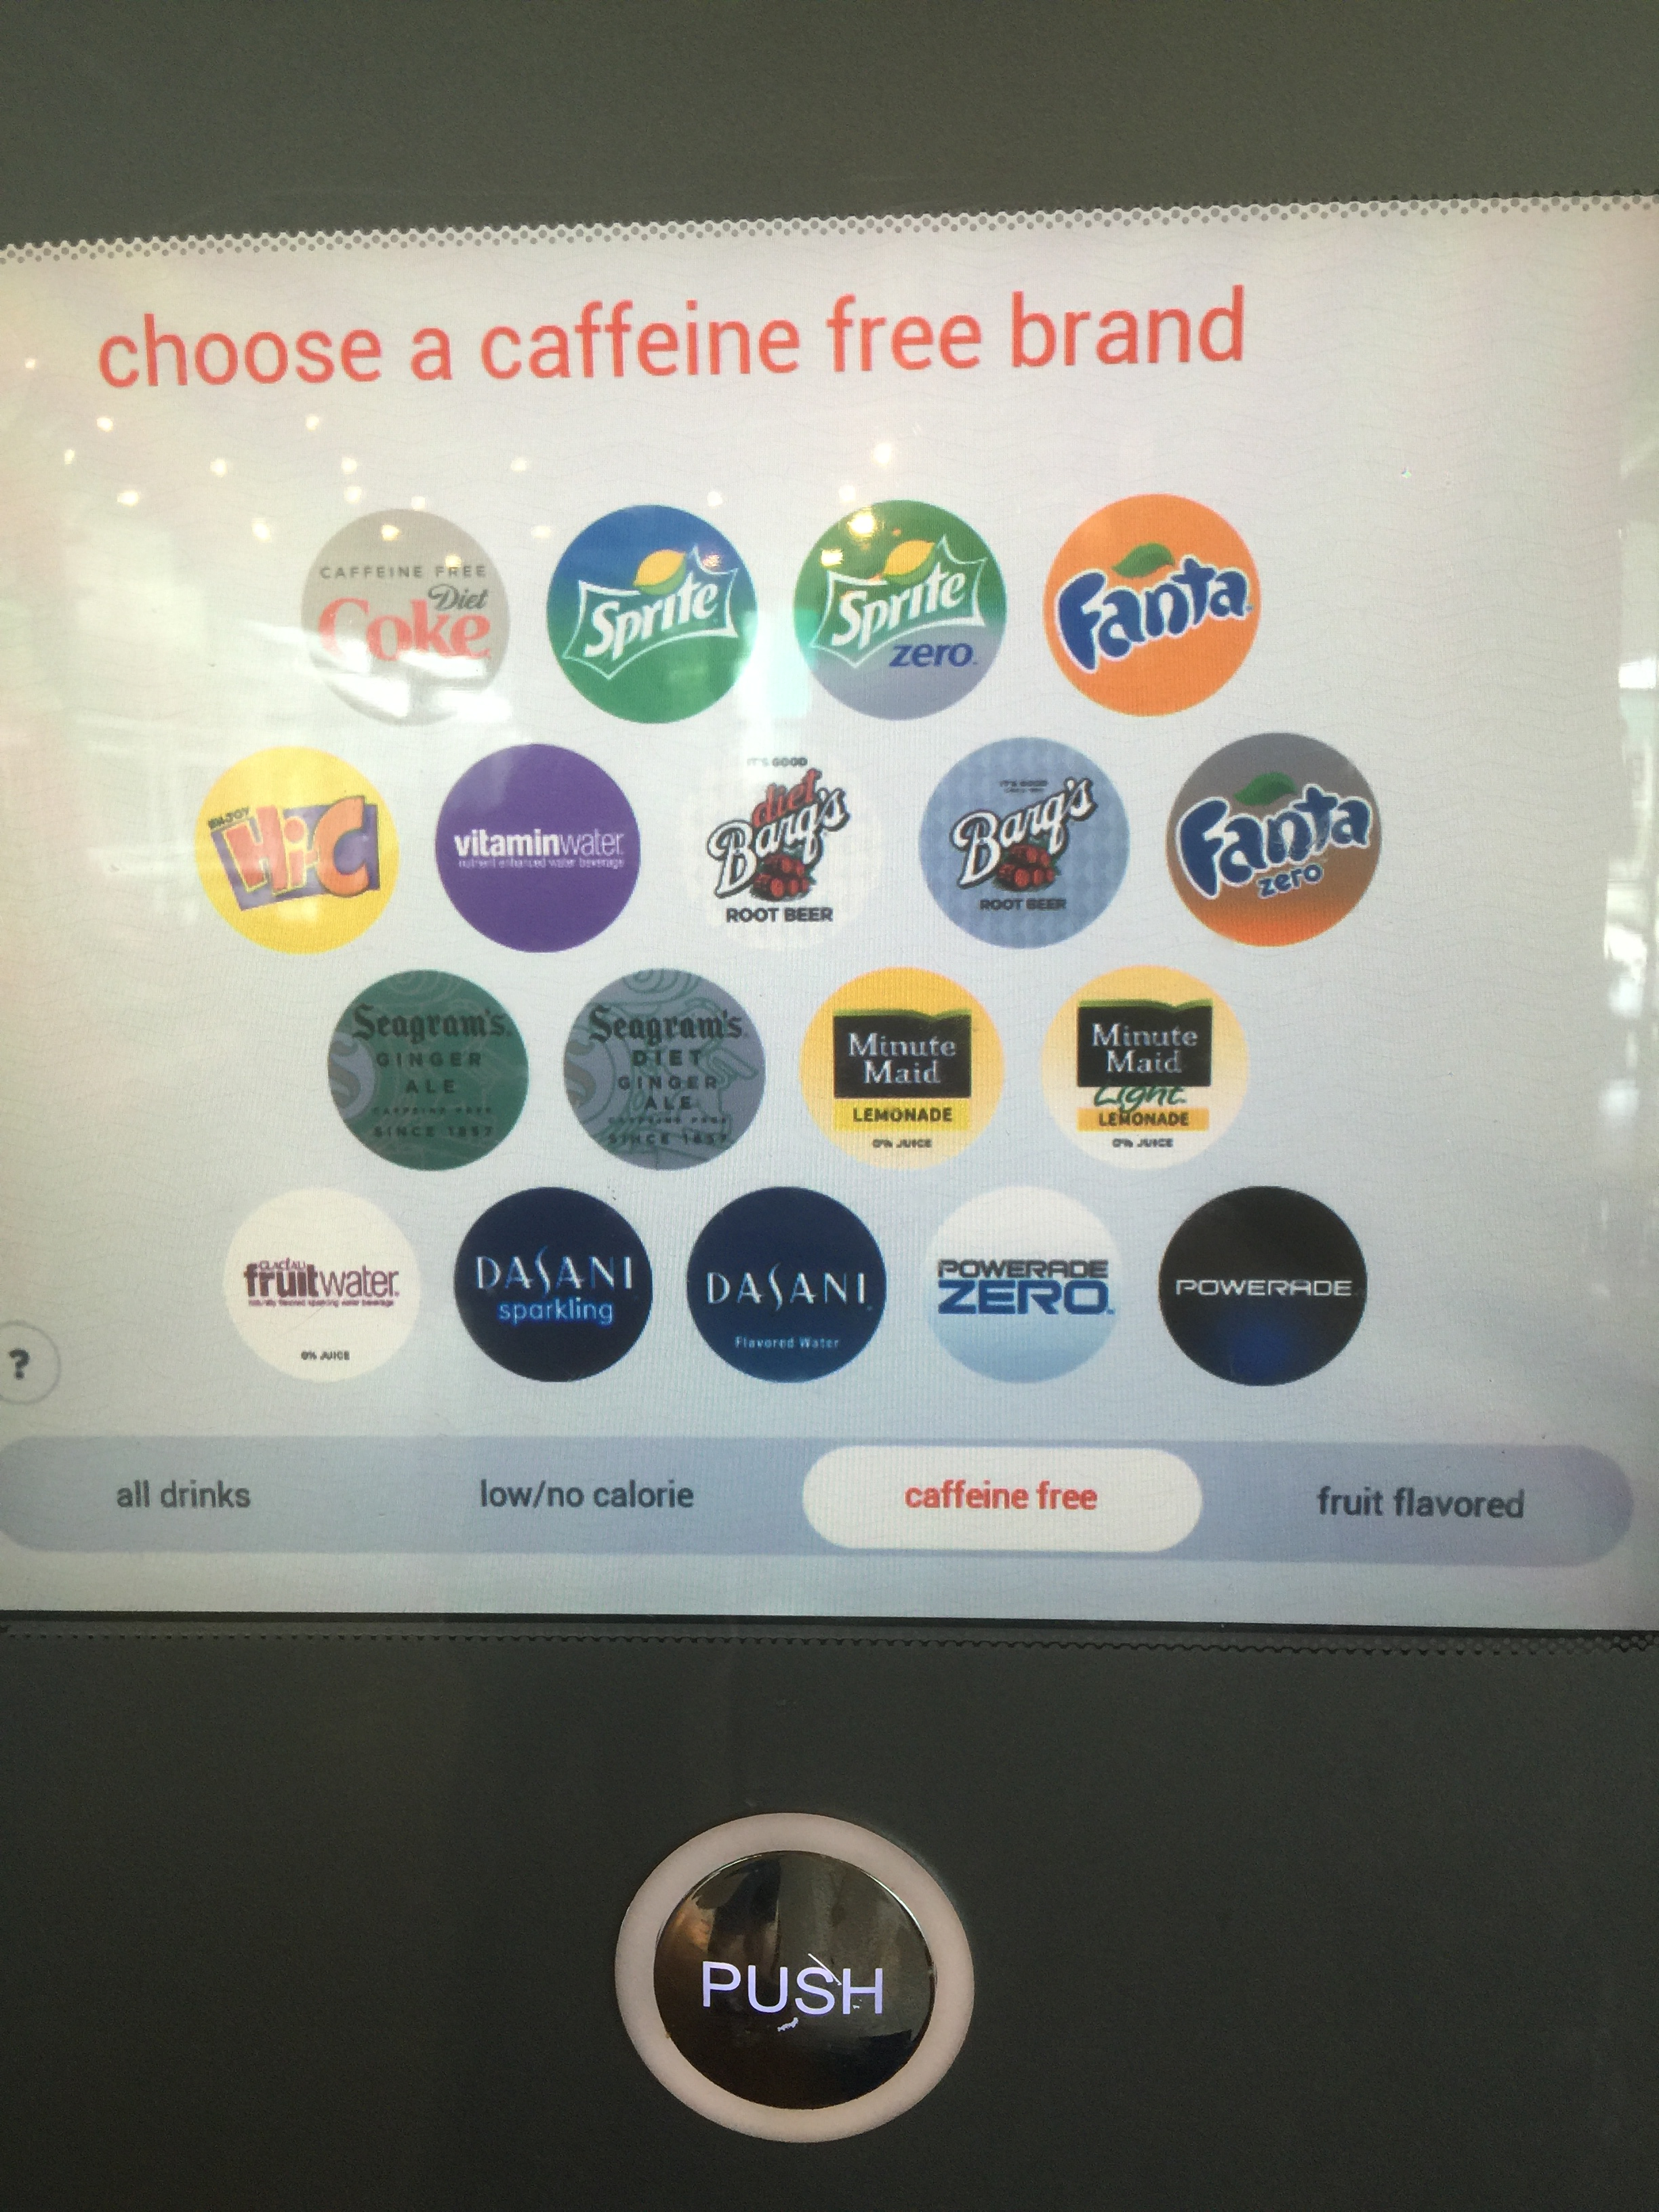
Product Description – Task Flow
4 categories of drinks the user can select

Slide 9
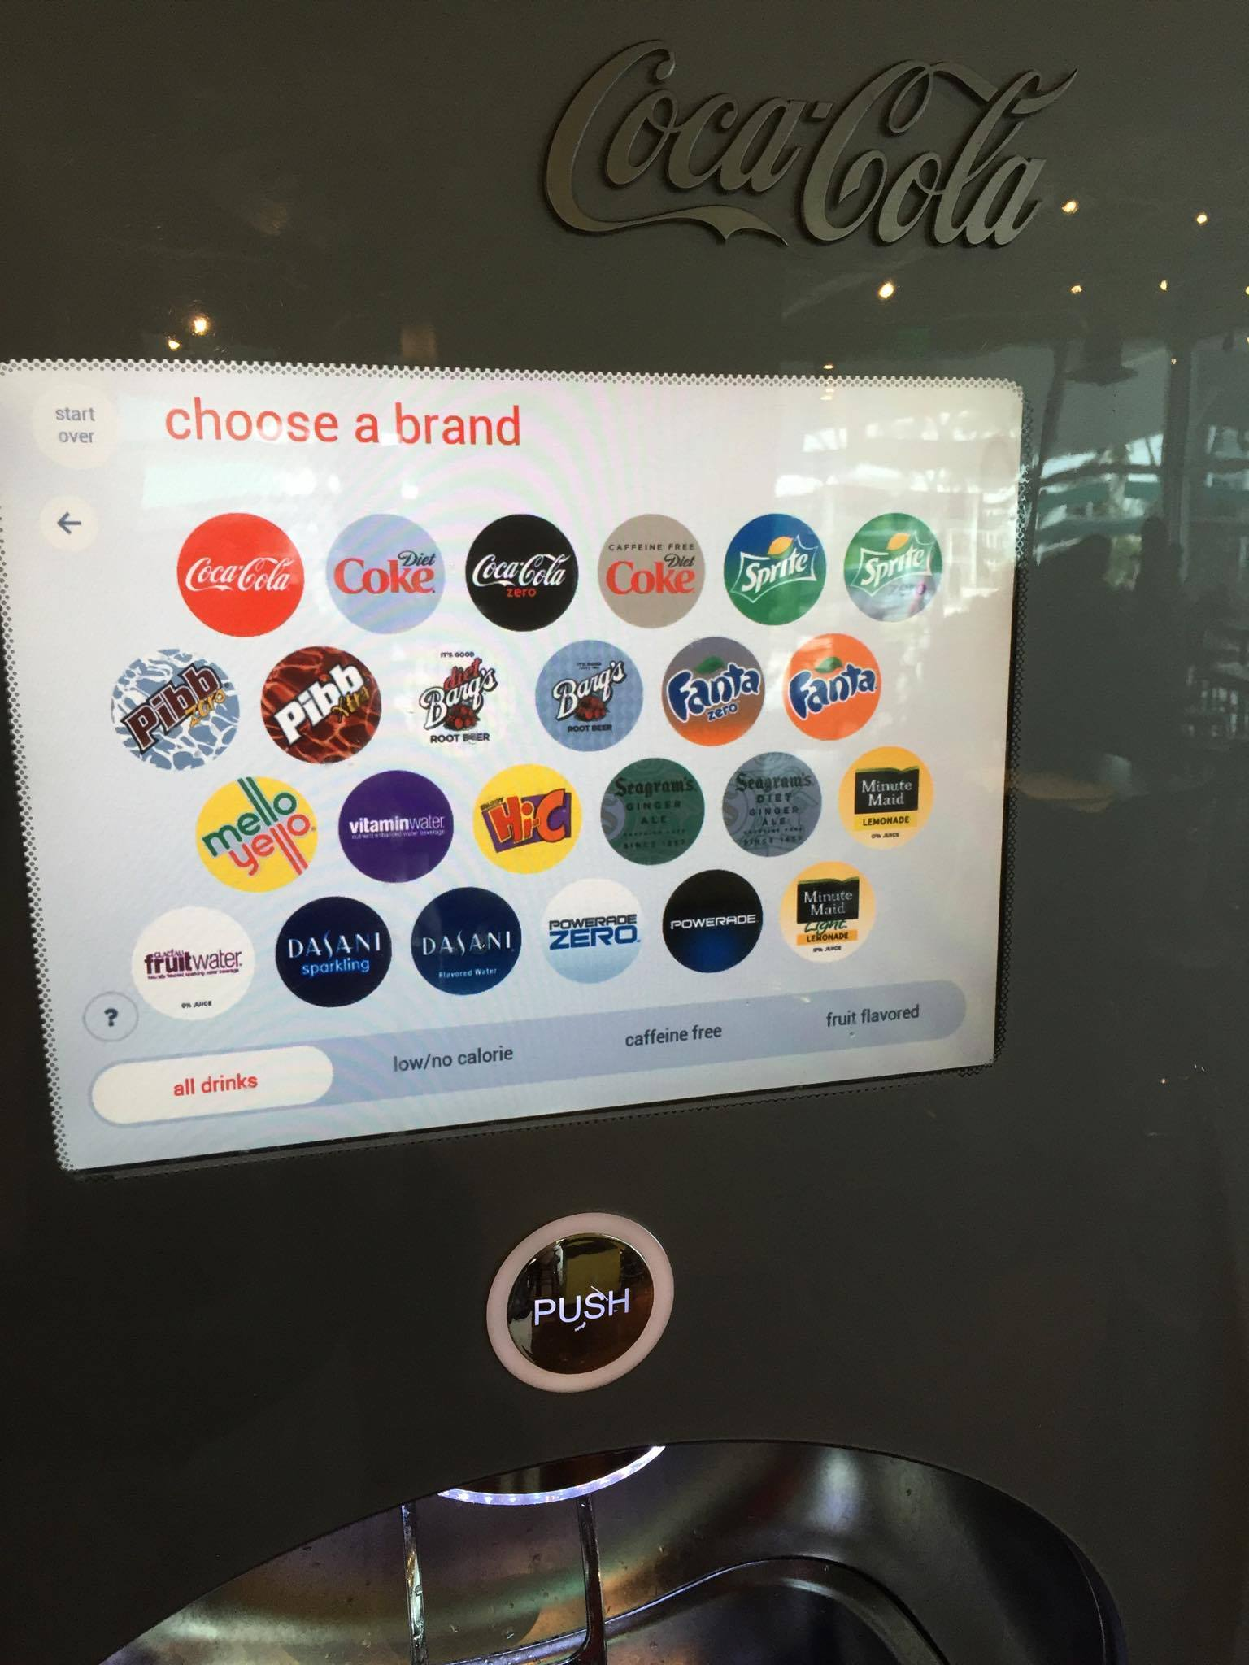
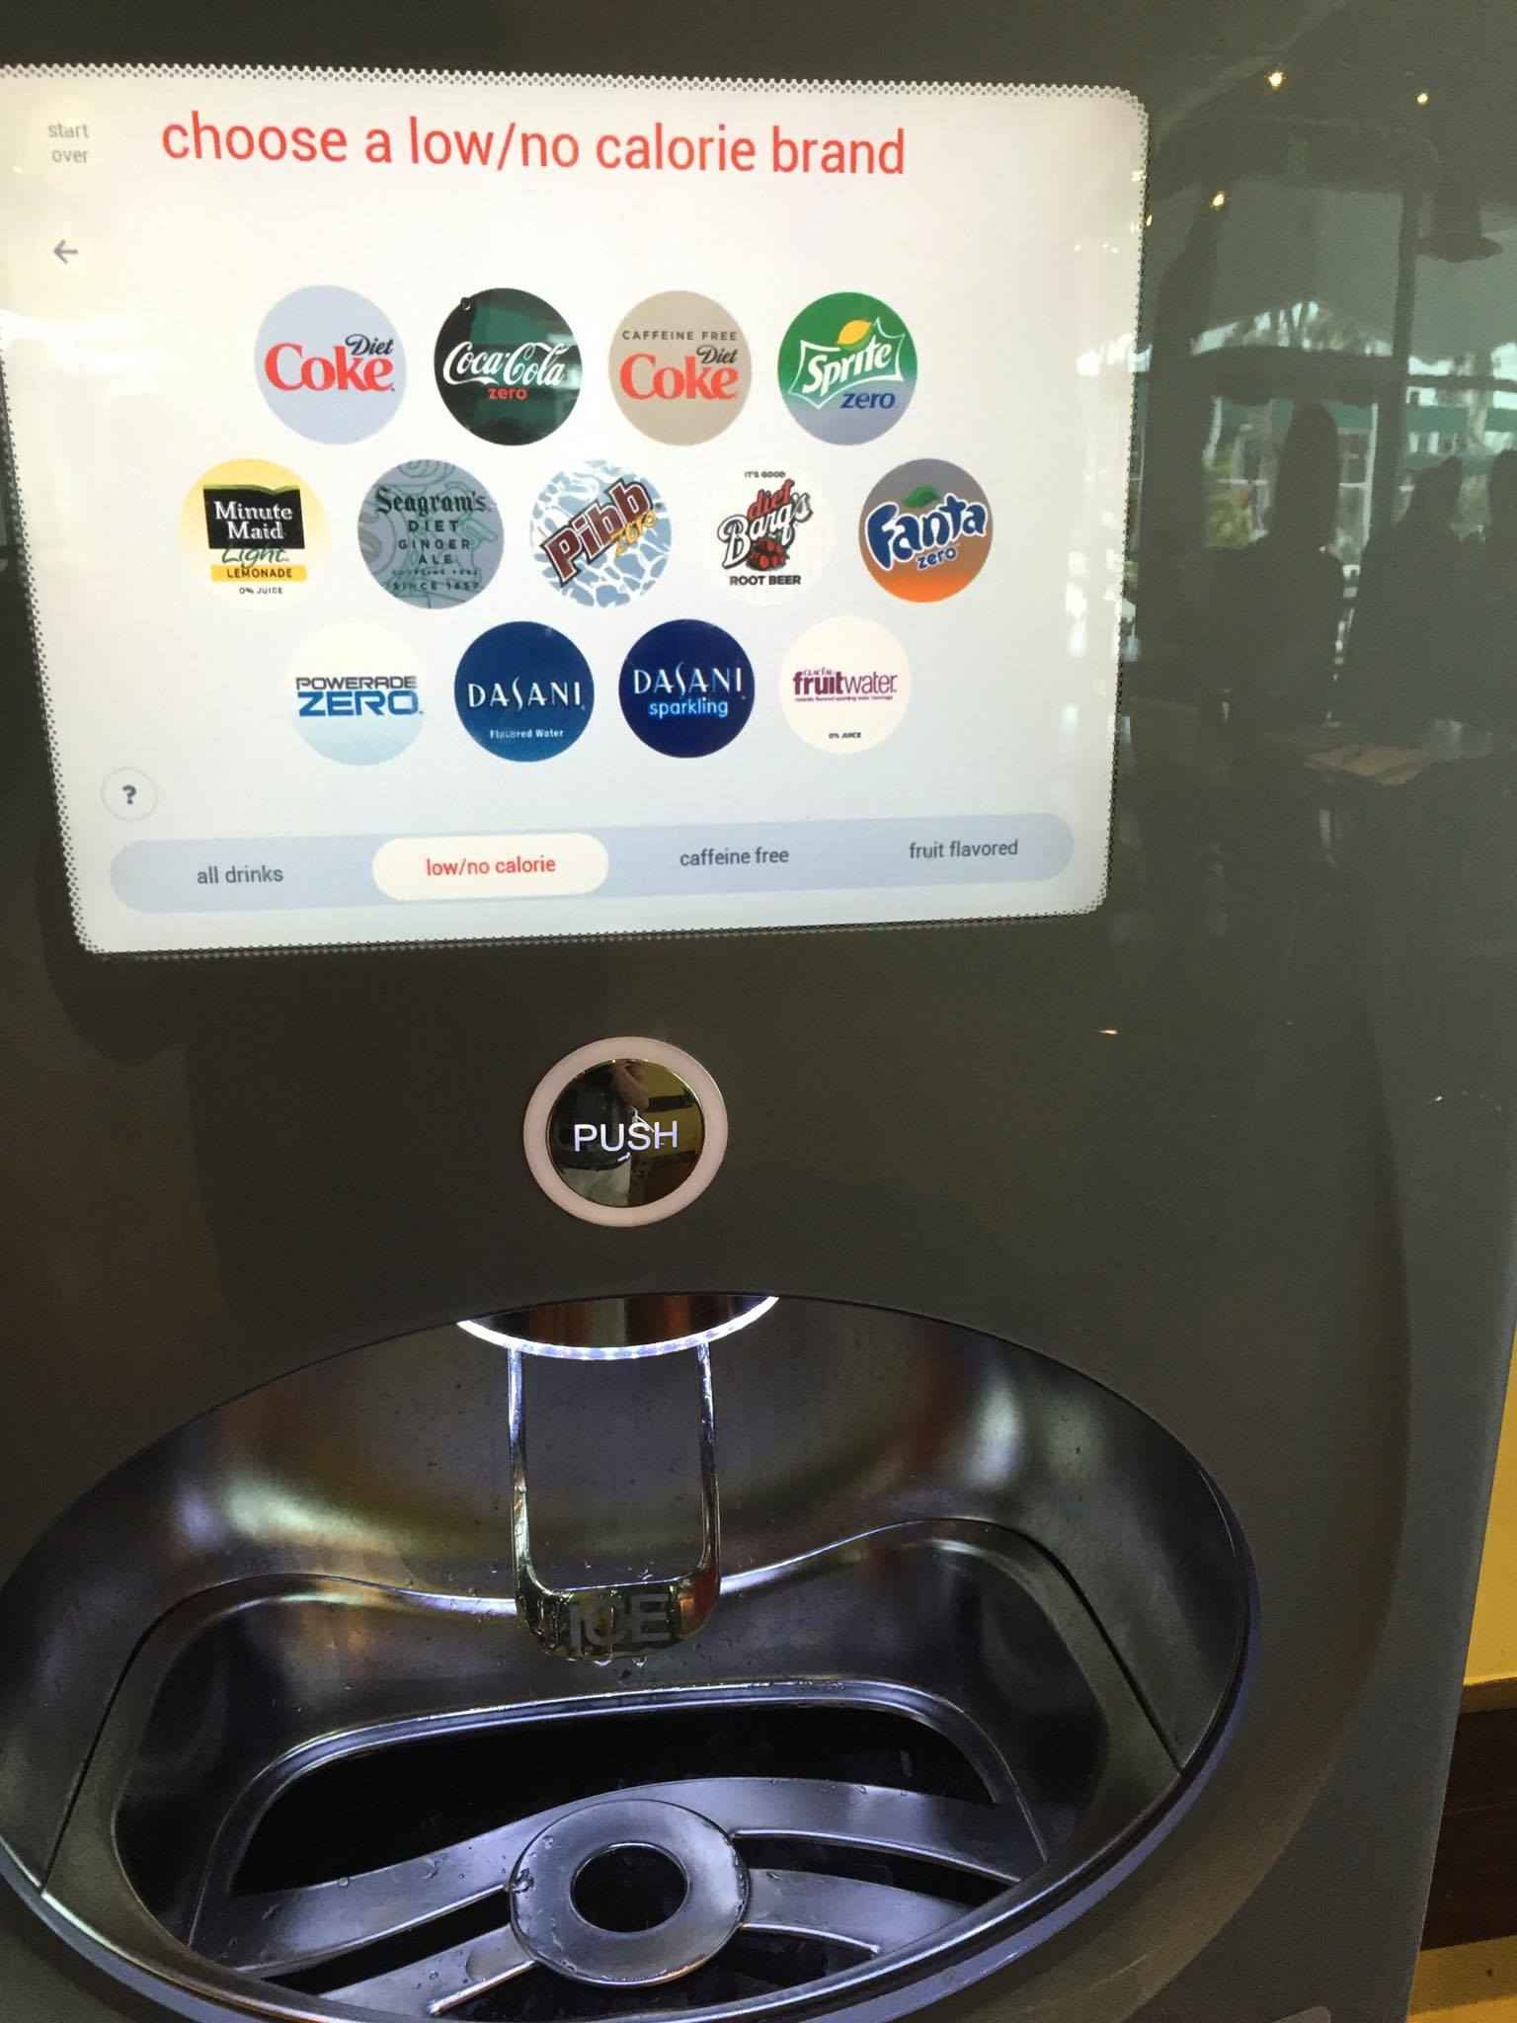
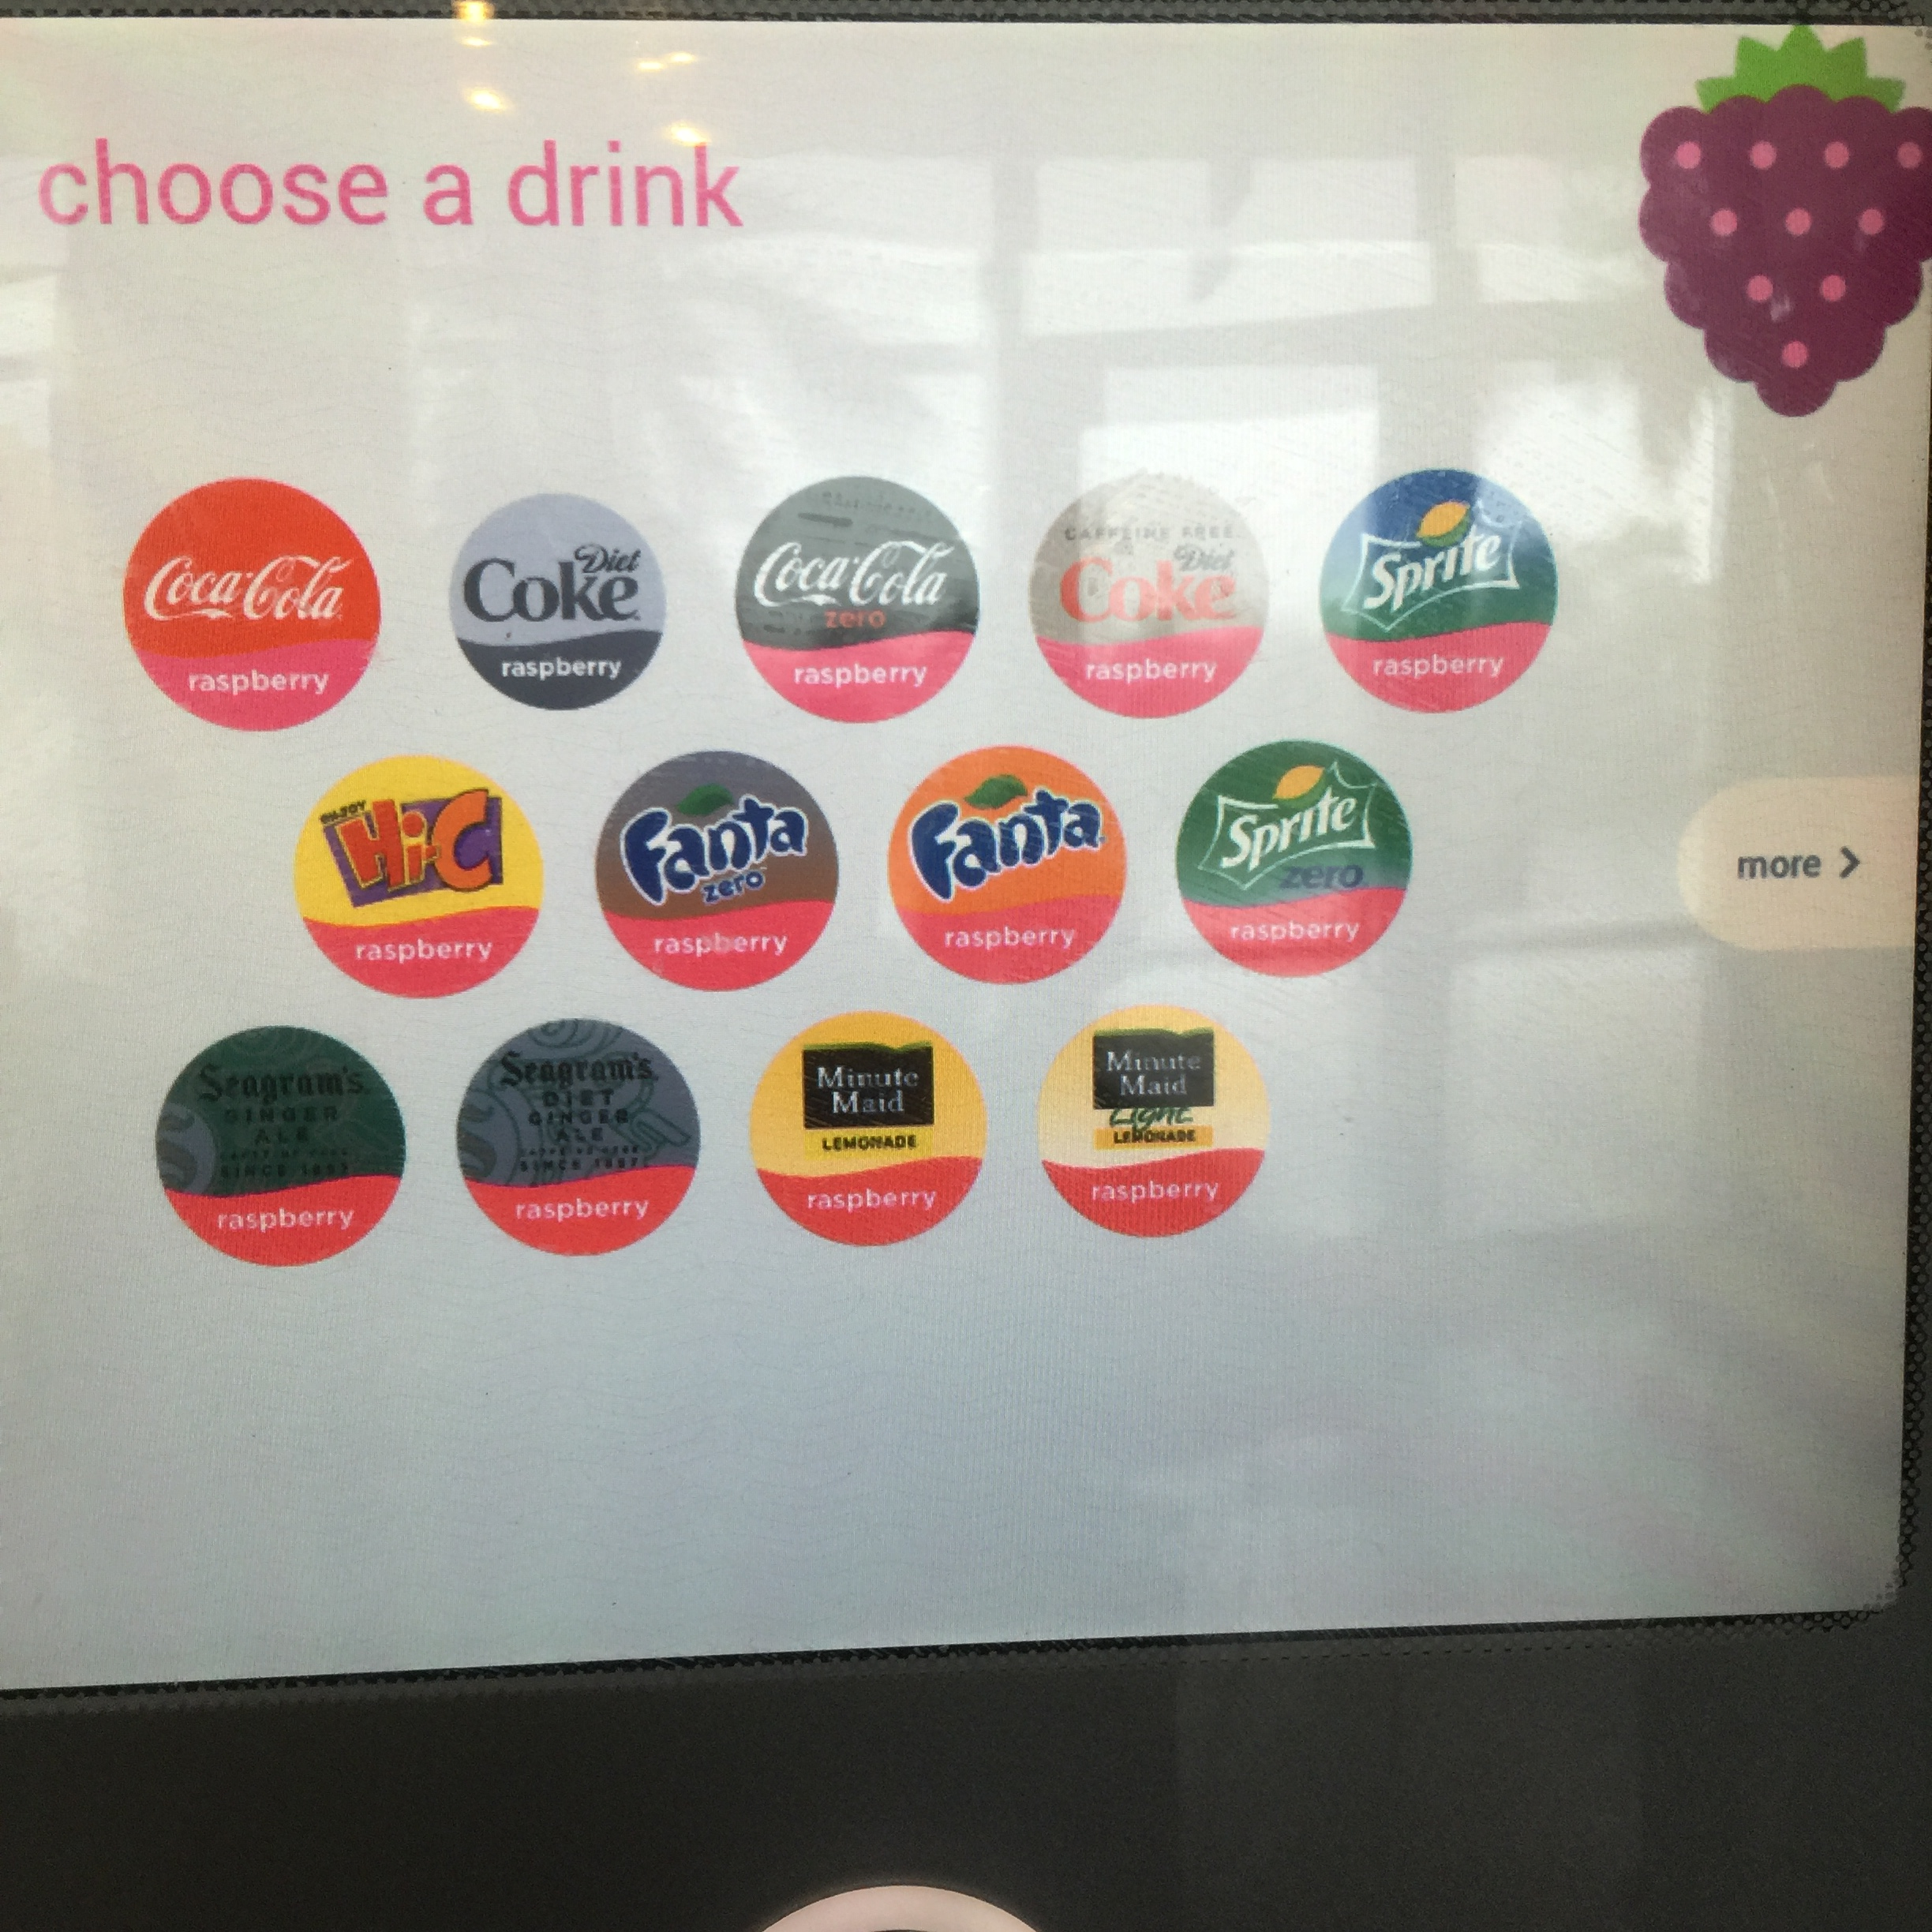
Product Description – Pictures
Main Screen
All Drinks
Low Calorie Drinks
Options by Fruit Flavor

Slide 10
Methods
Participants/Demographics:
14 Participants
4 females, 12 males
Ages 18+
Asked 8/14 participants them to answer survey questions (6 males, 2 females)
Equipment:
Pens – to take notes, for participant surveys
Paper - to write notes on
Printed copies of interviews to fill out
Printer – to print out notes to make affinity diagram
Post-it Notes – affinity diagram
Phone – to take photos of machine
Computer – type out notes, create survey

Slide 11
Methods
Schedule:
Tues 1/26 – Conducted secondary product research on the Coke Freestyle machine. Explored functionality of the Coke Freestyle machine on campus.
Wed 1/27 – From 11am - 11:30am we talked about what we wanted to get out of our study and talked to the Lime employees. From 11:30am -12: 30am we conducted primary research and observed users interact with the machine.
Thursday 1/28 – Analyzed the data and came up with product problems
Friday 1/29 - Sunday 1/31 – Redesign and Report
Roles:
Note taking during observations (both)
Analyzing Data (both)
Redesign (both)

Slide 12
Methods
Procedure:
Conducted secondary research on the Coke Freestyle product
Went to machine to explore the functionality of the machine
Created an observation field guide and list 5 survey questions to ask our participants
Met at lime to conduct primary research
Found a good location to observe users, spoke to employees and got background information on the machine
Sat in Lime on campus for an hour and observed users’ interactions with the machine and took notes
Approached 8/14 of the users as they waited for their food and asked them our survey questions
Combined all of the answers and observations to find common themes using an affinity diagram
Picked out specific problems with the machine and made recommendations to change those specific problems
Came up with illustrations and wireframes for the redesign

Slide 13
Methods
Field Guide (n=14)
How long do people take?
What drinks do people get?
Is there a variety in drinks/is there a common drink?
What problems do people have?
Is the interface easy to navigate?
Do people take a while to chose a drink?
Can people find the ice?
Are people using the Coke Freestyle App?
Survey Questions (n=8)
What do you like about Coke Freestyle?
What would you change about Coke Freestyle?
Do you like to experiment with the flavors? What other flavors have you tried?
Does this machine make you more/less likely to order a soda at a restaurant? Why?
Have you ever downloaded the Coke Freestyle App or followed them on social media? What was your experience?

Slide 14
Findings: Observations
People selected a variety of different drinks:
4 people selected water
7 people selected a beverage with no flavoring
4 Selected a beverage with flavoring
People spent a variety of different times at the machine
8 people spent about 10 seconds
4 people spent between 10 and 20 seconds
4 people spent more than about 30 seconds
Of the 4 people that selected water, 3 of them had trouble locating and dispensing the water
8 people got ice, 3 people poured ice out of the cup after dispensing it
5 people repeatedly pressed the ‘Push’ button to dispense the beverage to fill it up all the way
4 people couldn’t find the ice, one person even turning around to her friend and asking where it was
6 people hesitated on pages or went back pages while looking for a drink choice
4 people struggled with the touch screen, pressing items multiple times trying to make the screen work

Slide 15
Findings: Voices
All 8 people surveyed had never used the app or seen the Coke Freestyle social media
5 people did not like to try different flavors, 3 did
2 people said it did make them more likely to order soda, 6 said it didn't
Things people like:
I think it’s a fun way to order drinks.
Easy to use. Offers a choice.
More choices than a regular soda machine.
Large variety of drink options
Variety of flavors
It is interesting to use the digital display
Keeps water cold
Things people would change:
It does not come with instructions so you have to figure out how the machine works.
Nothing
One one dispenser leads to backed up lines everywhere
I would make the water button a separate button so you don’t have to use the interface to navigate to it.
Less ice being dispensed
Perhaps make the display cover closer to the touch screen for better accuracy.
Make the water button a one button process

Slide 16
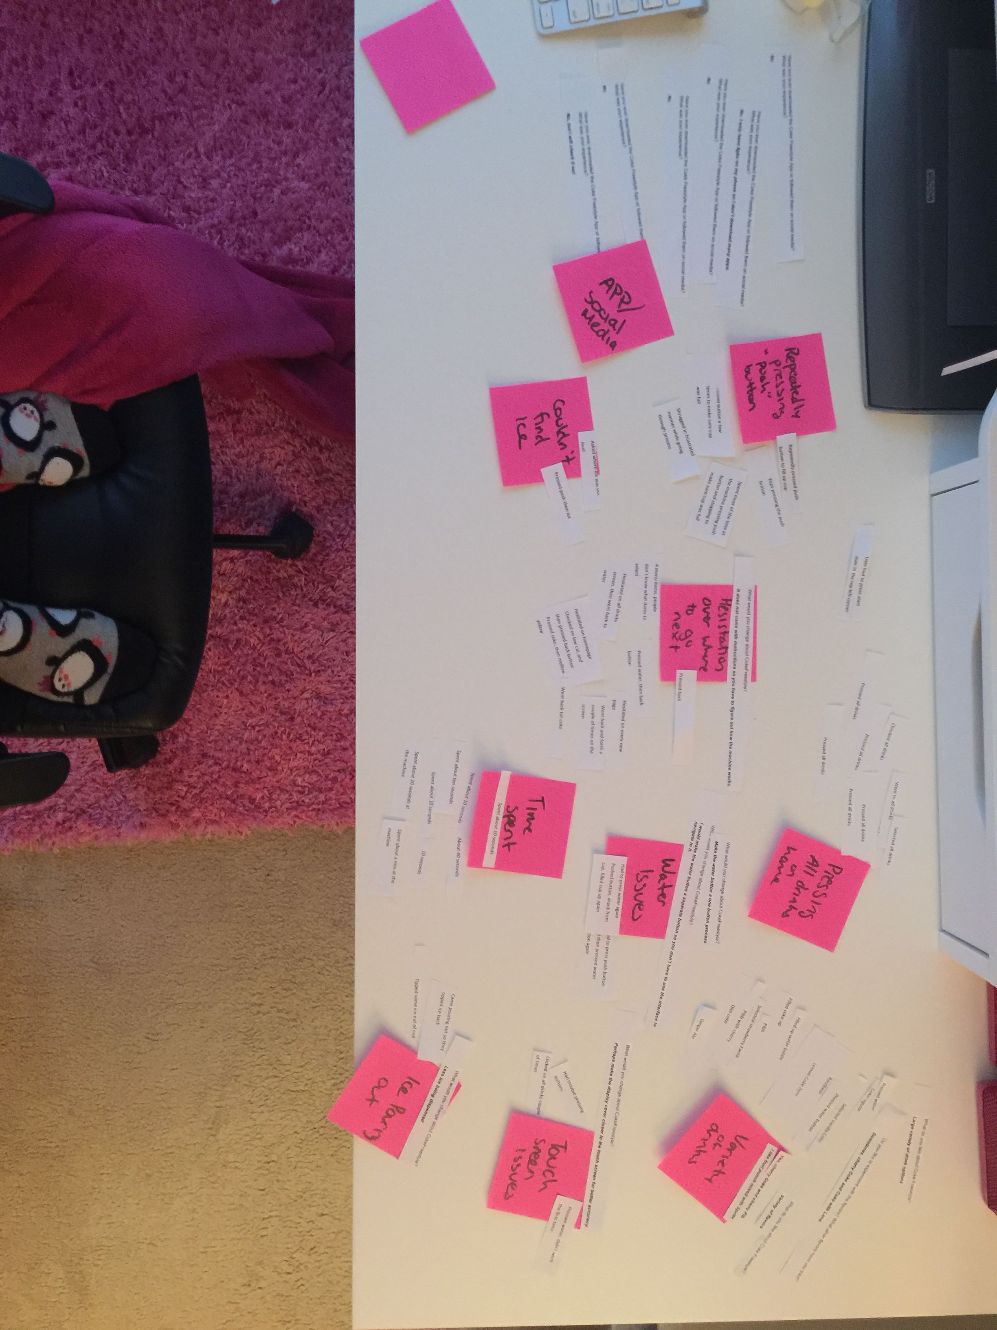
Findings
Affinity Diagram:

Slide 17
Findings - Themes
Inefficiencies
Not a multi-serve system
Takes time for user to make choices
Users not understanding how to use the system
Lack of Intuitive Design
Buttons are not clear, too small
Navigation issues
Help button doesn’t make machine easier to use
Variety
Users selected different drinks
Users followed different pattern for selecting drinks
Waste
Ice poured out fast enough that users threw it away
Soda came out to fast
Time spent selecting drink
Time spent waiting for pages to load on screen
Opportunity to promote application

Slide 18
Findings: Problems
Problem: Water is difficult to locate
Observations/Voices:
4 out of 16 people selected water
Of the 4 people that selected water, 2 of them couldn’t find the water
One person clicked all drinks and went back and forth on a few pages to look for it
“I would make the water button a separate button so you don’t have to use the interface to navigate to it.”
Recommendation:
Take water out of the touch screen and create a physical button next to the ‘push’ button, so users don’t waste time searching for it on the screen.

Slide 19
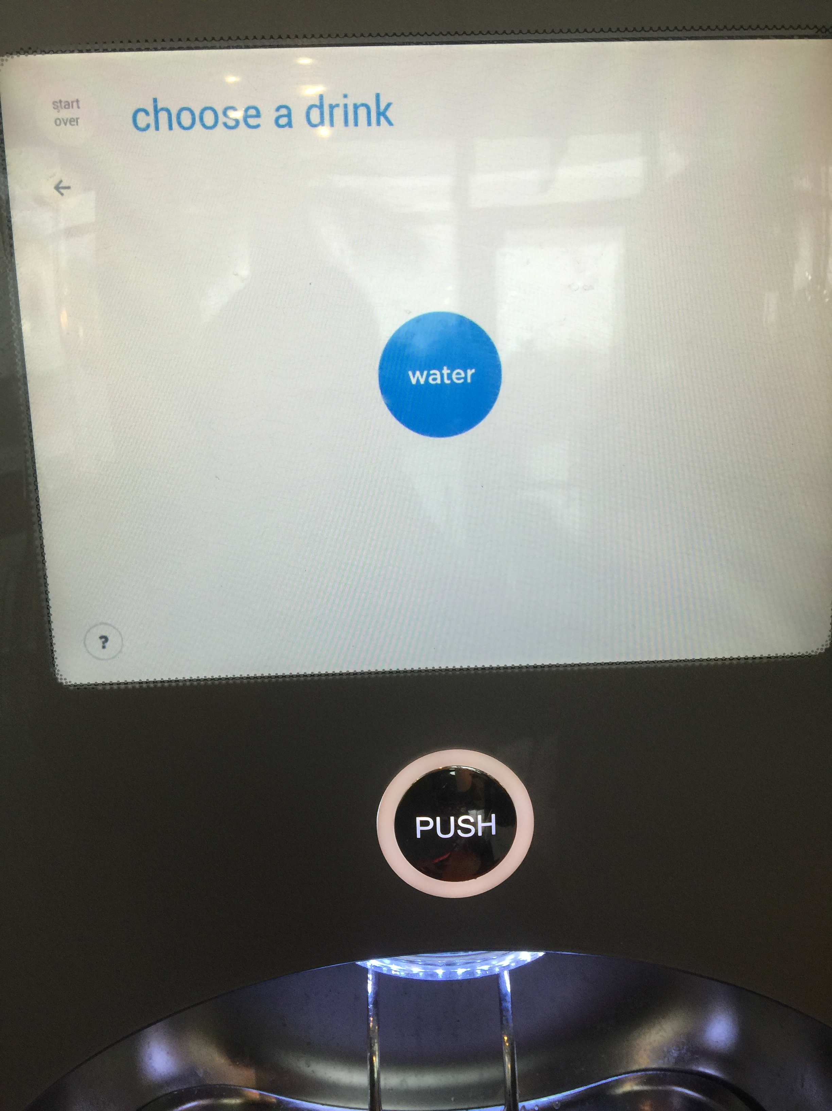
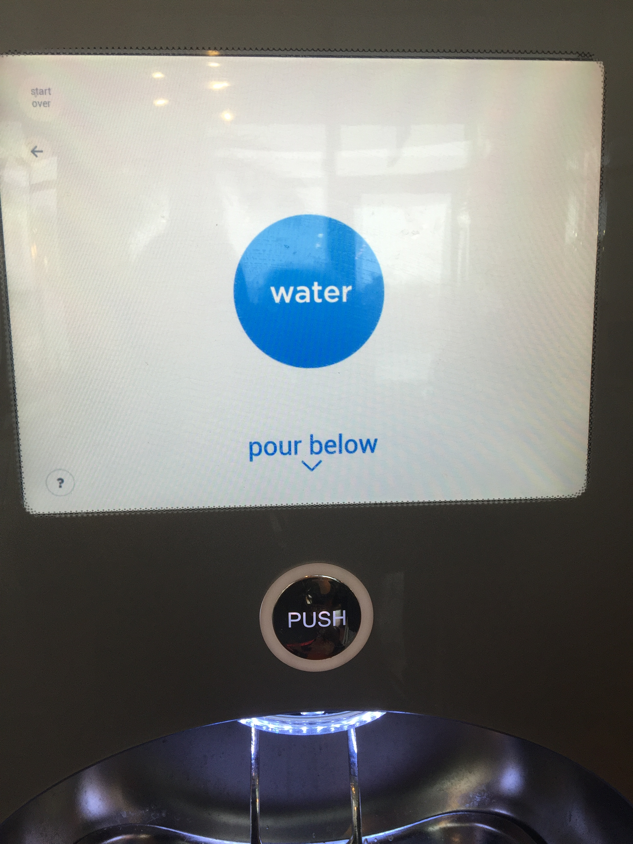
Findings: Problems
Problem: Water is a two step process
Observations/Voices:
4 out of 16 people selected water
One user selected the water button, tried to press the “push” button and pressed water again
Another user said: “Make the water button a one button process”
Recommendation:
Take water out of the touch screen and create a physical button next to the ‘push’ button. Water is a complementary beverage so it should be quick and easy for the user to get it, so they don’t spend more time than they need to at the machine.

Slide 20
Findings: Problems
Problem: Ice dispensing too fast
Observations/Voices:
3 people poured ice out of the cup after dispensing it
One user answered what would you change with: “Less ice being dispensed “
Recommendation:
The ice should be dispensed more slowly

Slide 21
Findings: Problems
Problem: People struggled to locate the ice dispenser
Observations/Voices:
Most people that wanted ice went for it first
4 people visibly struggled to find it, some clicking through different screens
One user even turned to their friend and asked where the ice was
Recommendation:
Change the design of the physical machine so the user can more easily see the flow of the machine – if the coke wave is moved to the middle of the machine the user’s eye will follow it down. The screen could then be made larger.
Remove ice lever and create a physical button next to the ‘push’ button

Slide 22
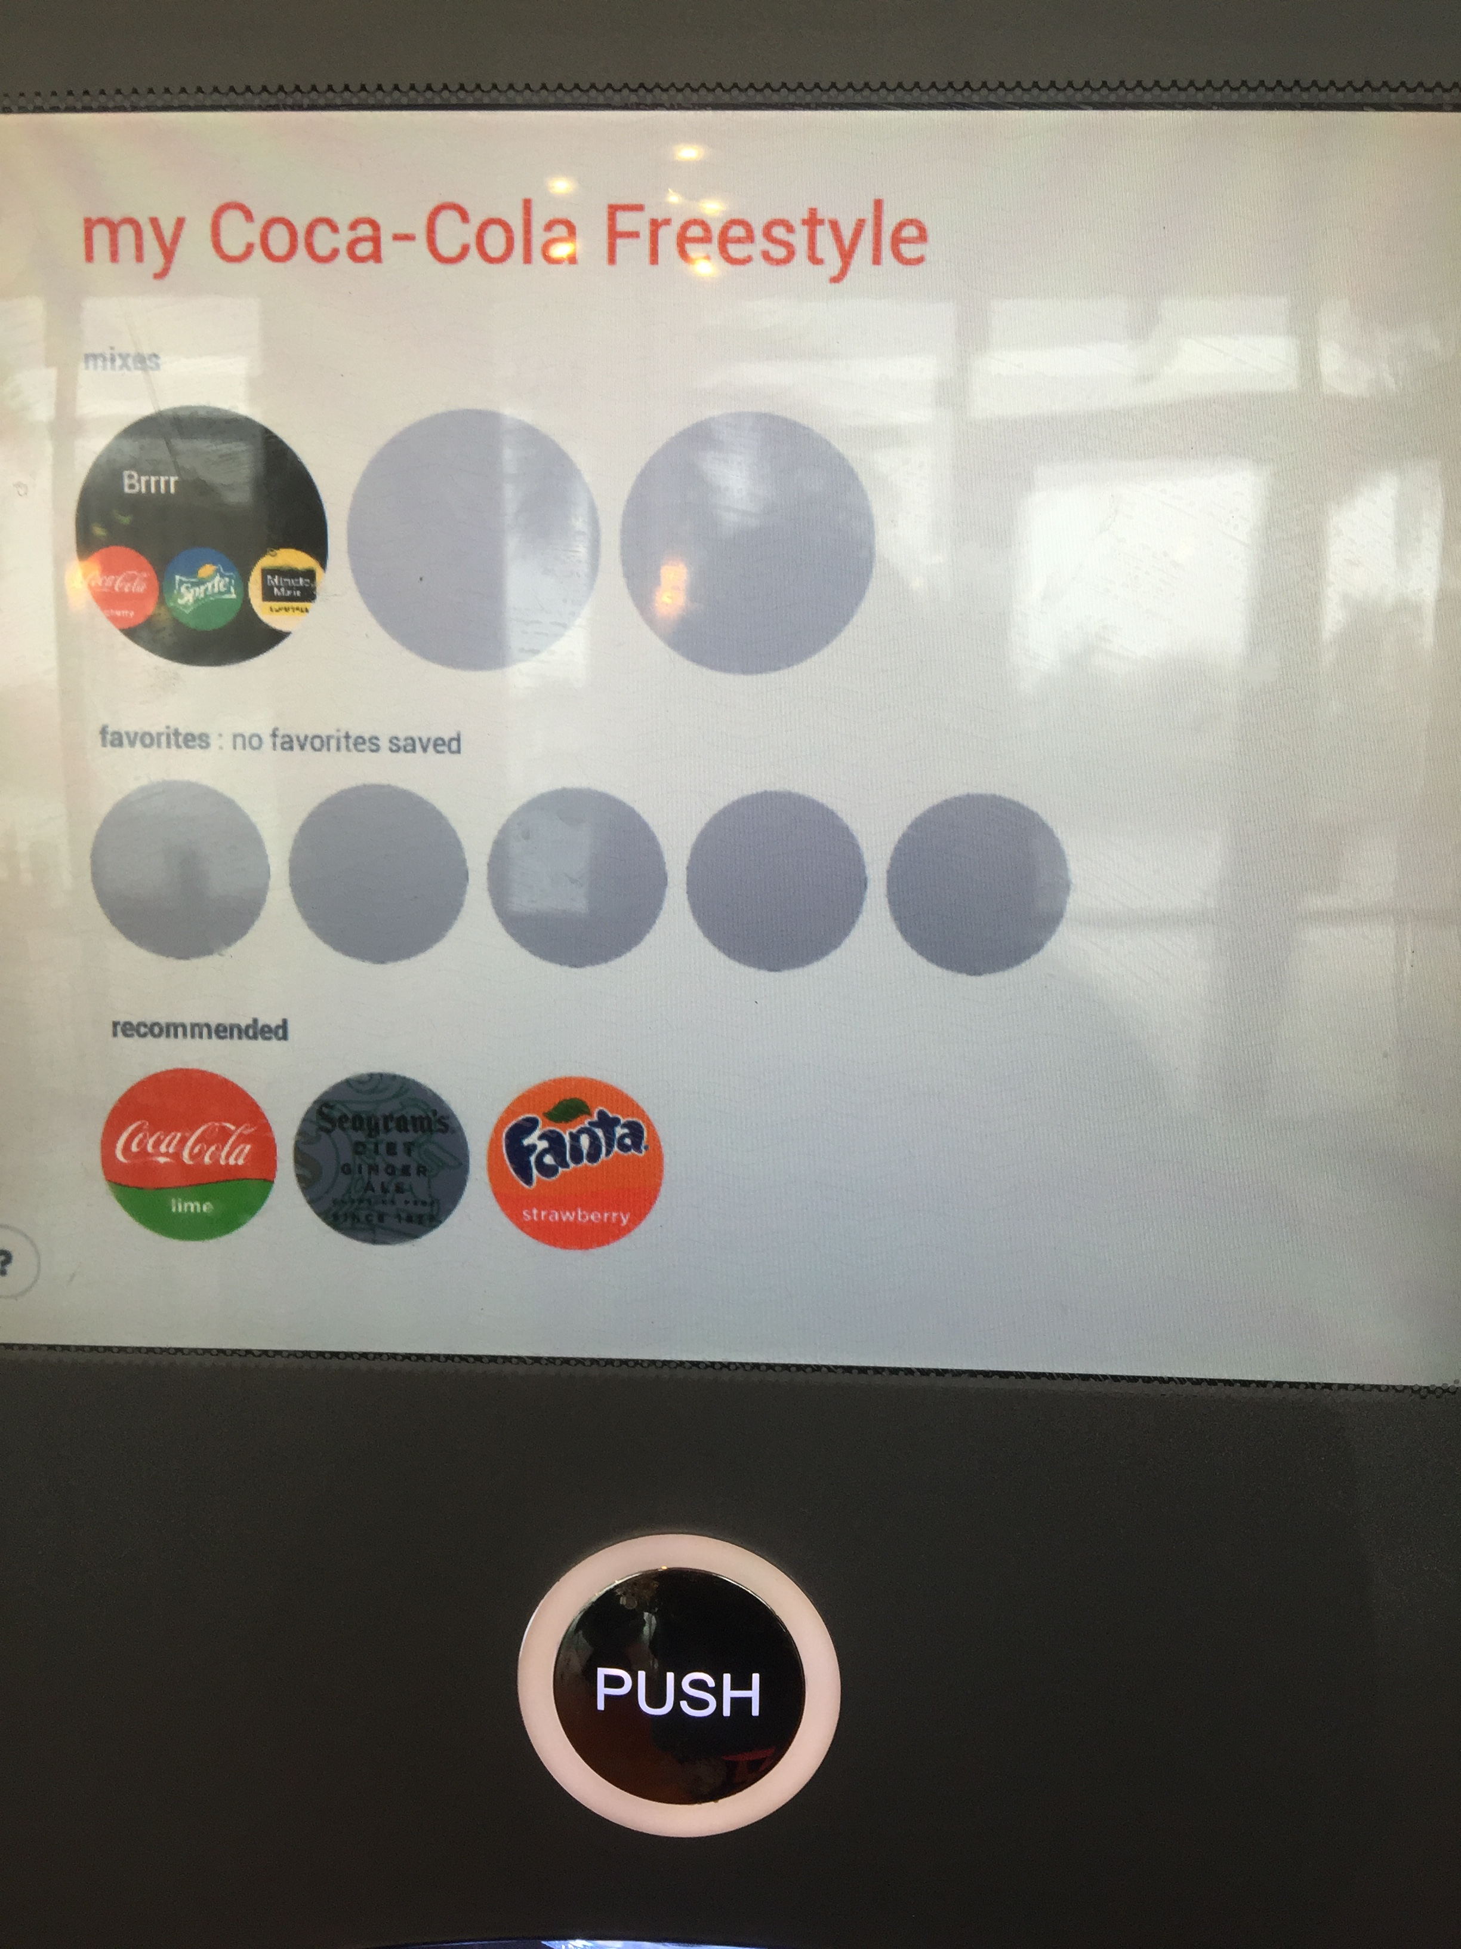
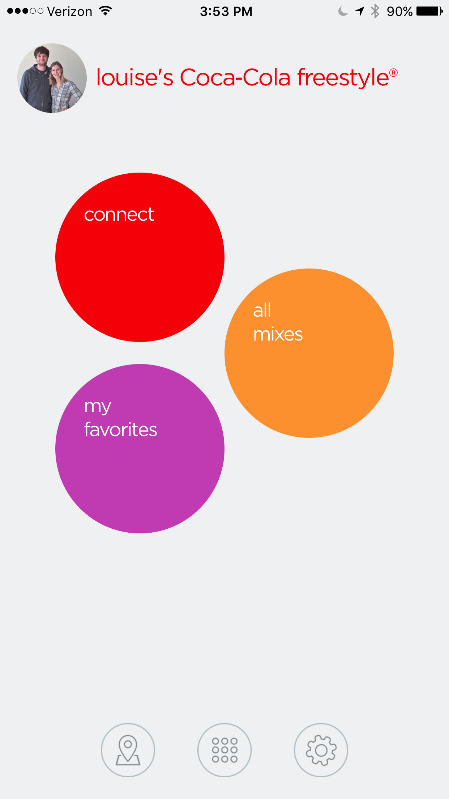
Findings: Problems
Problem: No participants knew about the app
Observations/Voices:
No one used the QR code on the home screen
Of all the participants we spoke to, none had downloaded the app or even heard of it
Recommendation:
Make it more clear what the QR code does and is for since none of our users new what it was for.
A QR code has the affordance of something that should be scanned to give the phone information, not a way to send the coke machine information. The App should have a barcode and the user should hold their phone up to the screen.

Slide 23
Findings: Problems
Problem: Touch screen sensitivity
Observations/Voices:
One user suggested: “Perhaps make the display cover closer to the touch screen for better accuracy.”
4 people struggled with the touch screen, pressing items multiple times trying to make the screen work
One user became so frustrated that the machine was not responding to her touch that she threw her hands in the air
If it didn't work the first time users would rapidly press on the touch screen
Recommendation:
Having an more responsive touch screen would solve the problem
Having less pages that a user needs to click through would alleviate some of the problems if the technology is not available to make a more accurate touch screen.

Slide 24
Findings: Problems
Problem: Lack of intuitive navigational design.
Observations/Voices:
A lime employee told us: “with the 4 menu items on the home screen people don’t know what items to select”
Another user said: “It does not come with instructions so you have to figure out how the machine works.”
One user pressed “all drinks”, then pressed back to find water
One user hesitated on the home page, pressed “low cal” then pressed the back button, then went to all drinks, then clicked on a drink, hovered over the screen for a while, found the back button before selecting coke
Recommendation:
There a too many different pages a user must click through, so it is easy to get lost in the interface. The user needs more feedback about what page they are on, and less pages to click through so they can locate what they are looking for.
Fruit flavored should be removed because it doesn’t fit in with the other three selections. All drinks shows all the brands of drinks and low/no calorie and caffeine free take the user to a subset all of the drinks. Fruit flavors lists all of the syrups a user can add to the drink.

Slide 25
Findings: Problems
Problem: One machine leads to longer wait times because there is a choice and people spend longer at this machine than they would at a traditional soda fountain
Observations/Voices:
4 participants spent more than 30 seconds standing at the machine
We observed 7 participants hesitate at different times in the process
One user went through 2 different drink choices before settling on one option
4 users pressed the back button at least once
The pages are slow to load on the machine
One user said the downside to the machine was: “One one dispenser leads to backed up lines everywhere”
If a user walks away from the machine the next user has to press the start over button to go back to the home page
Recommendation:
Make the pages on the machine load pages more quickly, have a view so they user can simply walk up to the machine and see all of the choices on the home screen

Slide 26
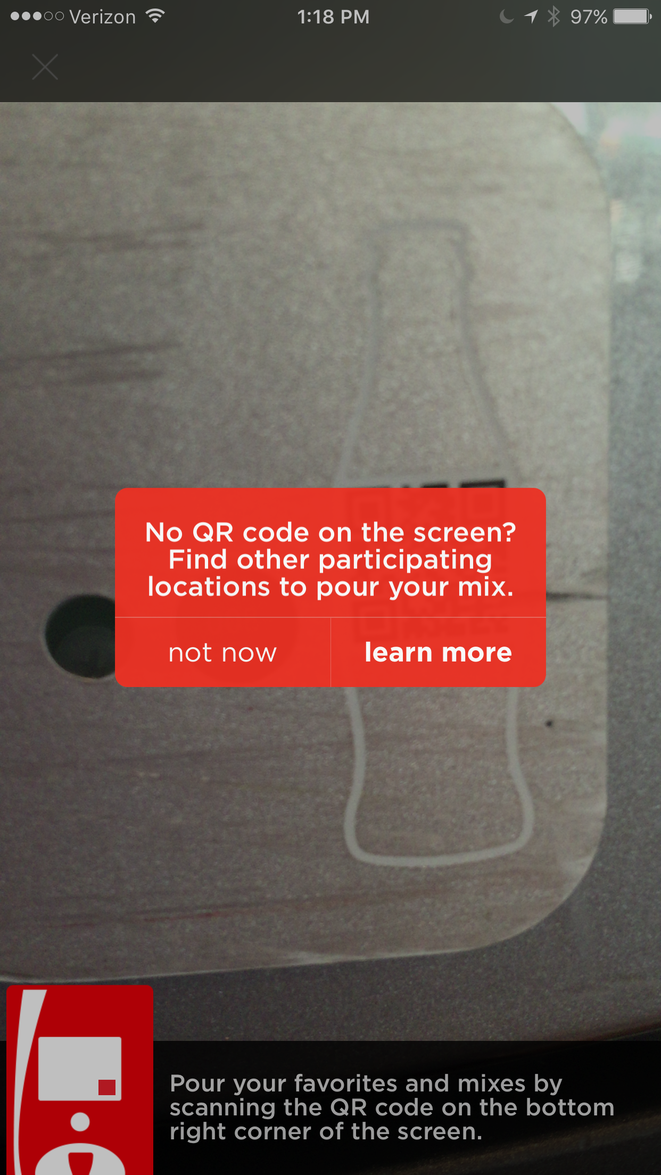
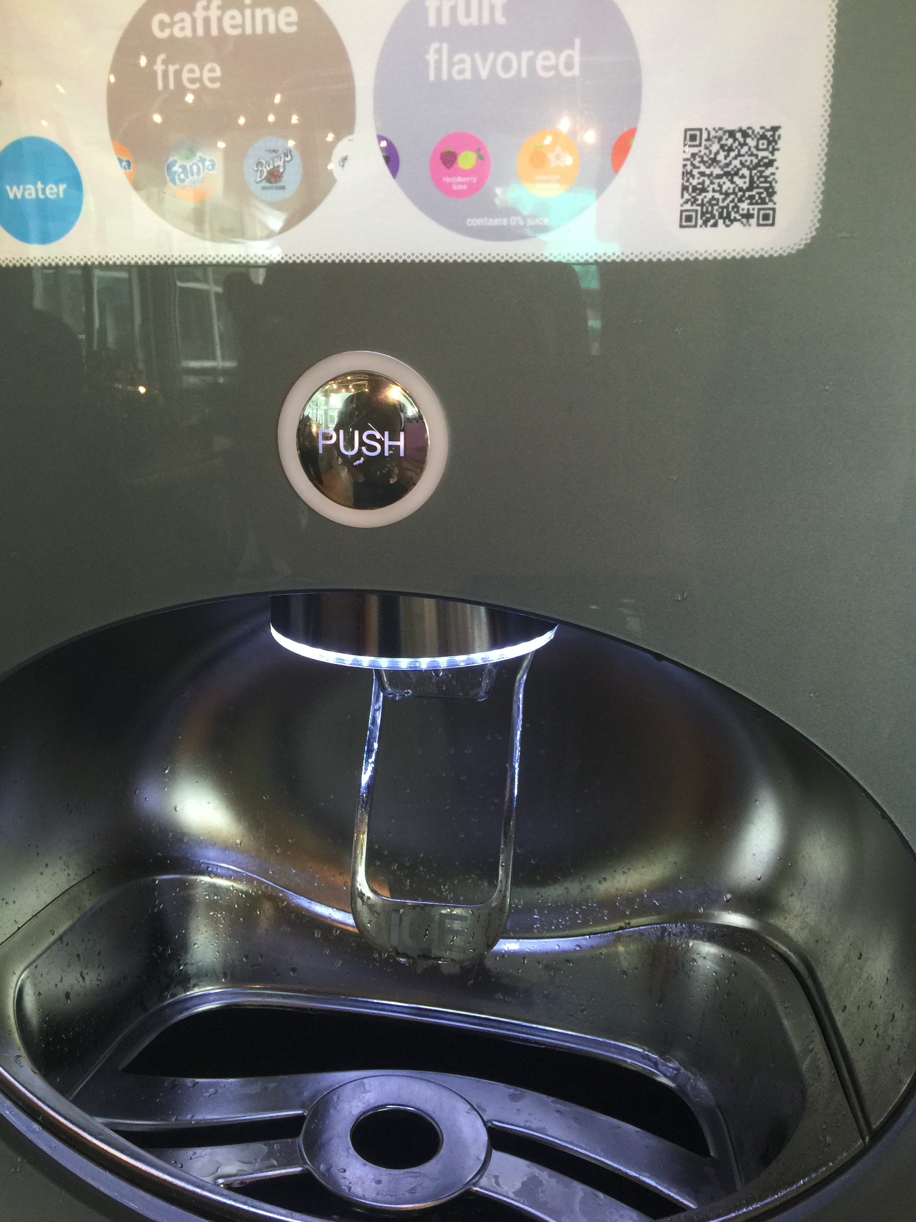
Findings: Other Problems *
There are two QR codes on the machine that do different things
The one below the ice dispenser is for the phone to scan so the user can download the app.
The one on the screen is so the user can connect their app with favorite drink choices to the machine.
*Problems we noticed but did not observe

Slide 27
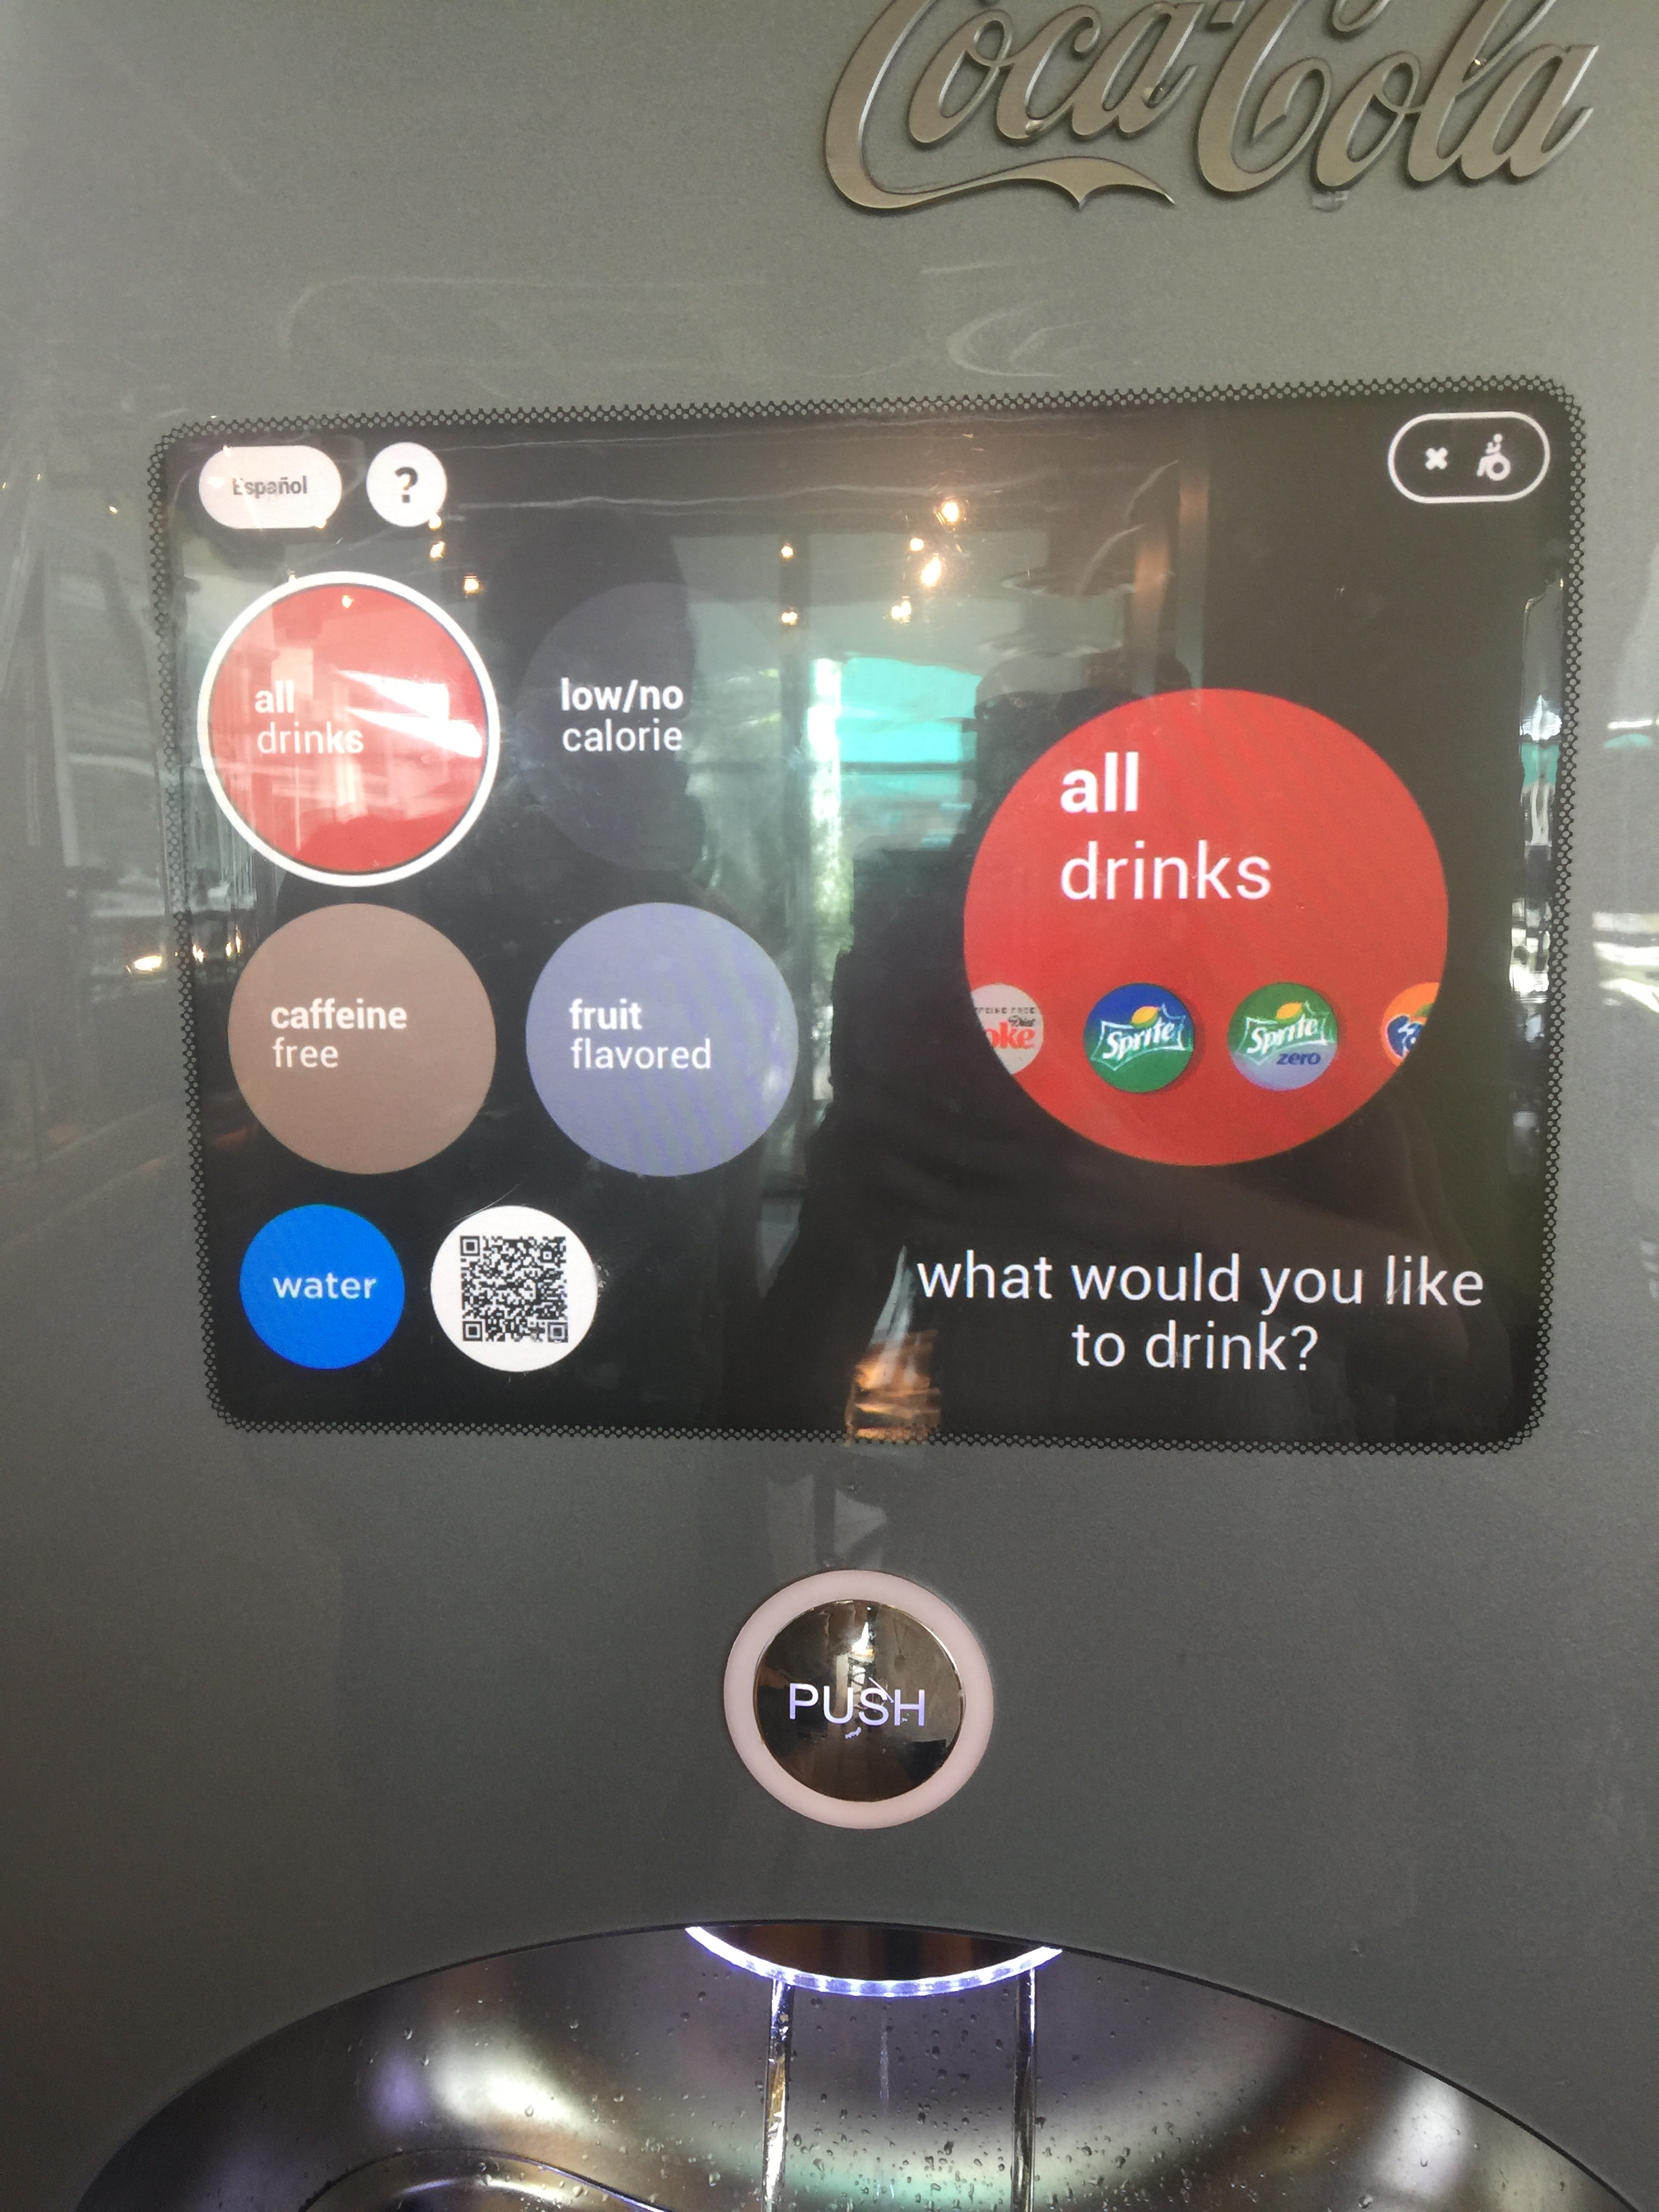
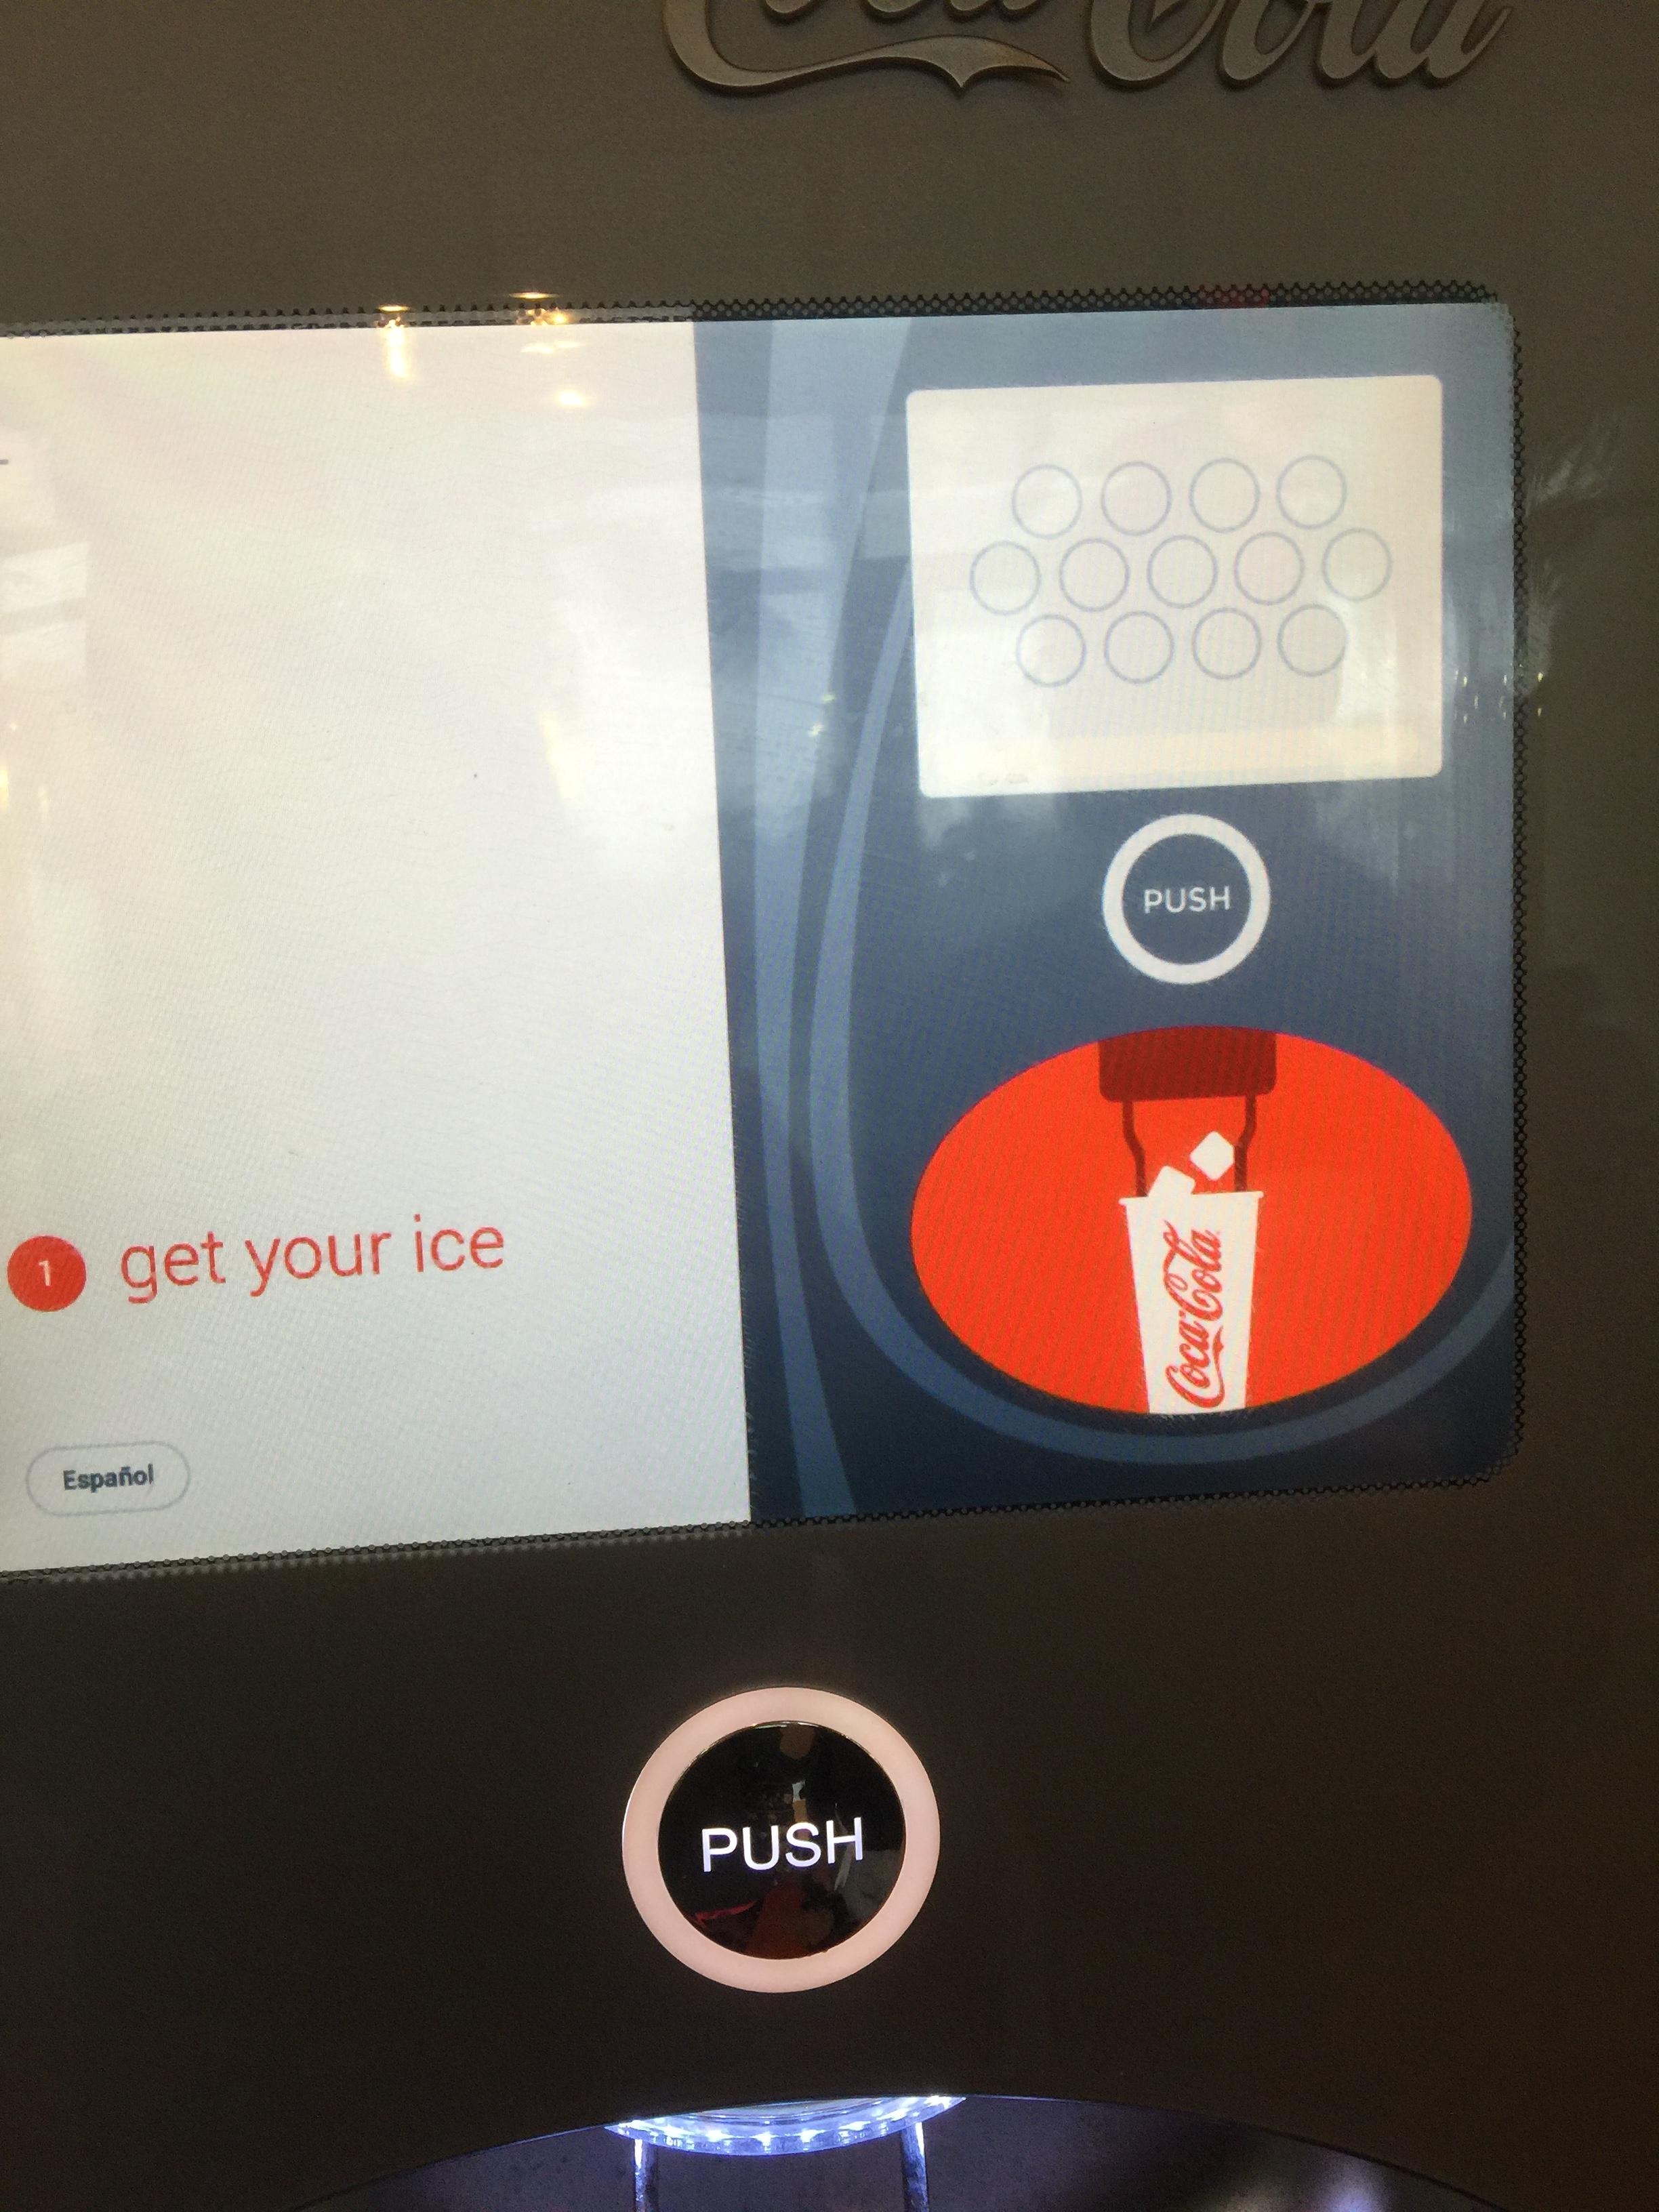
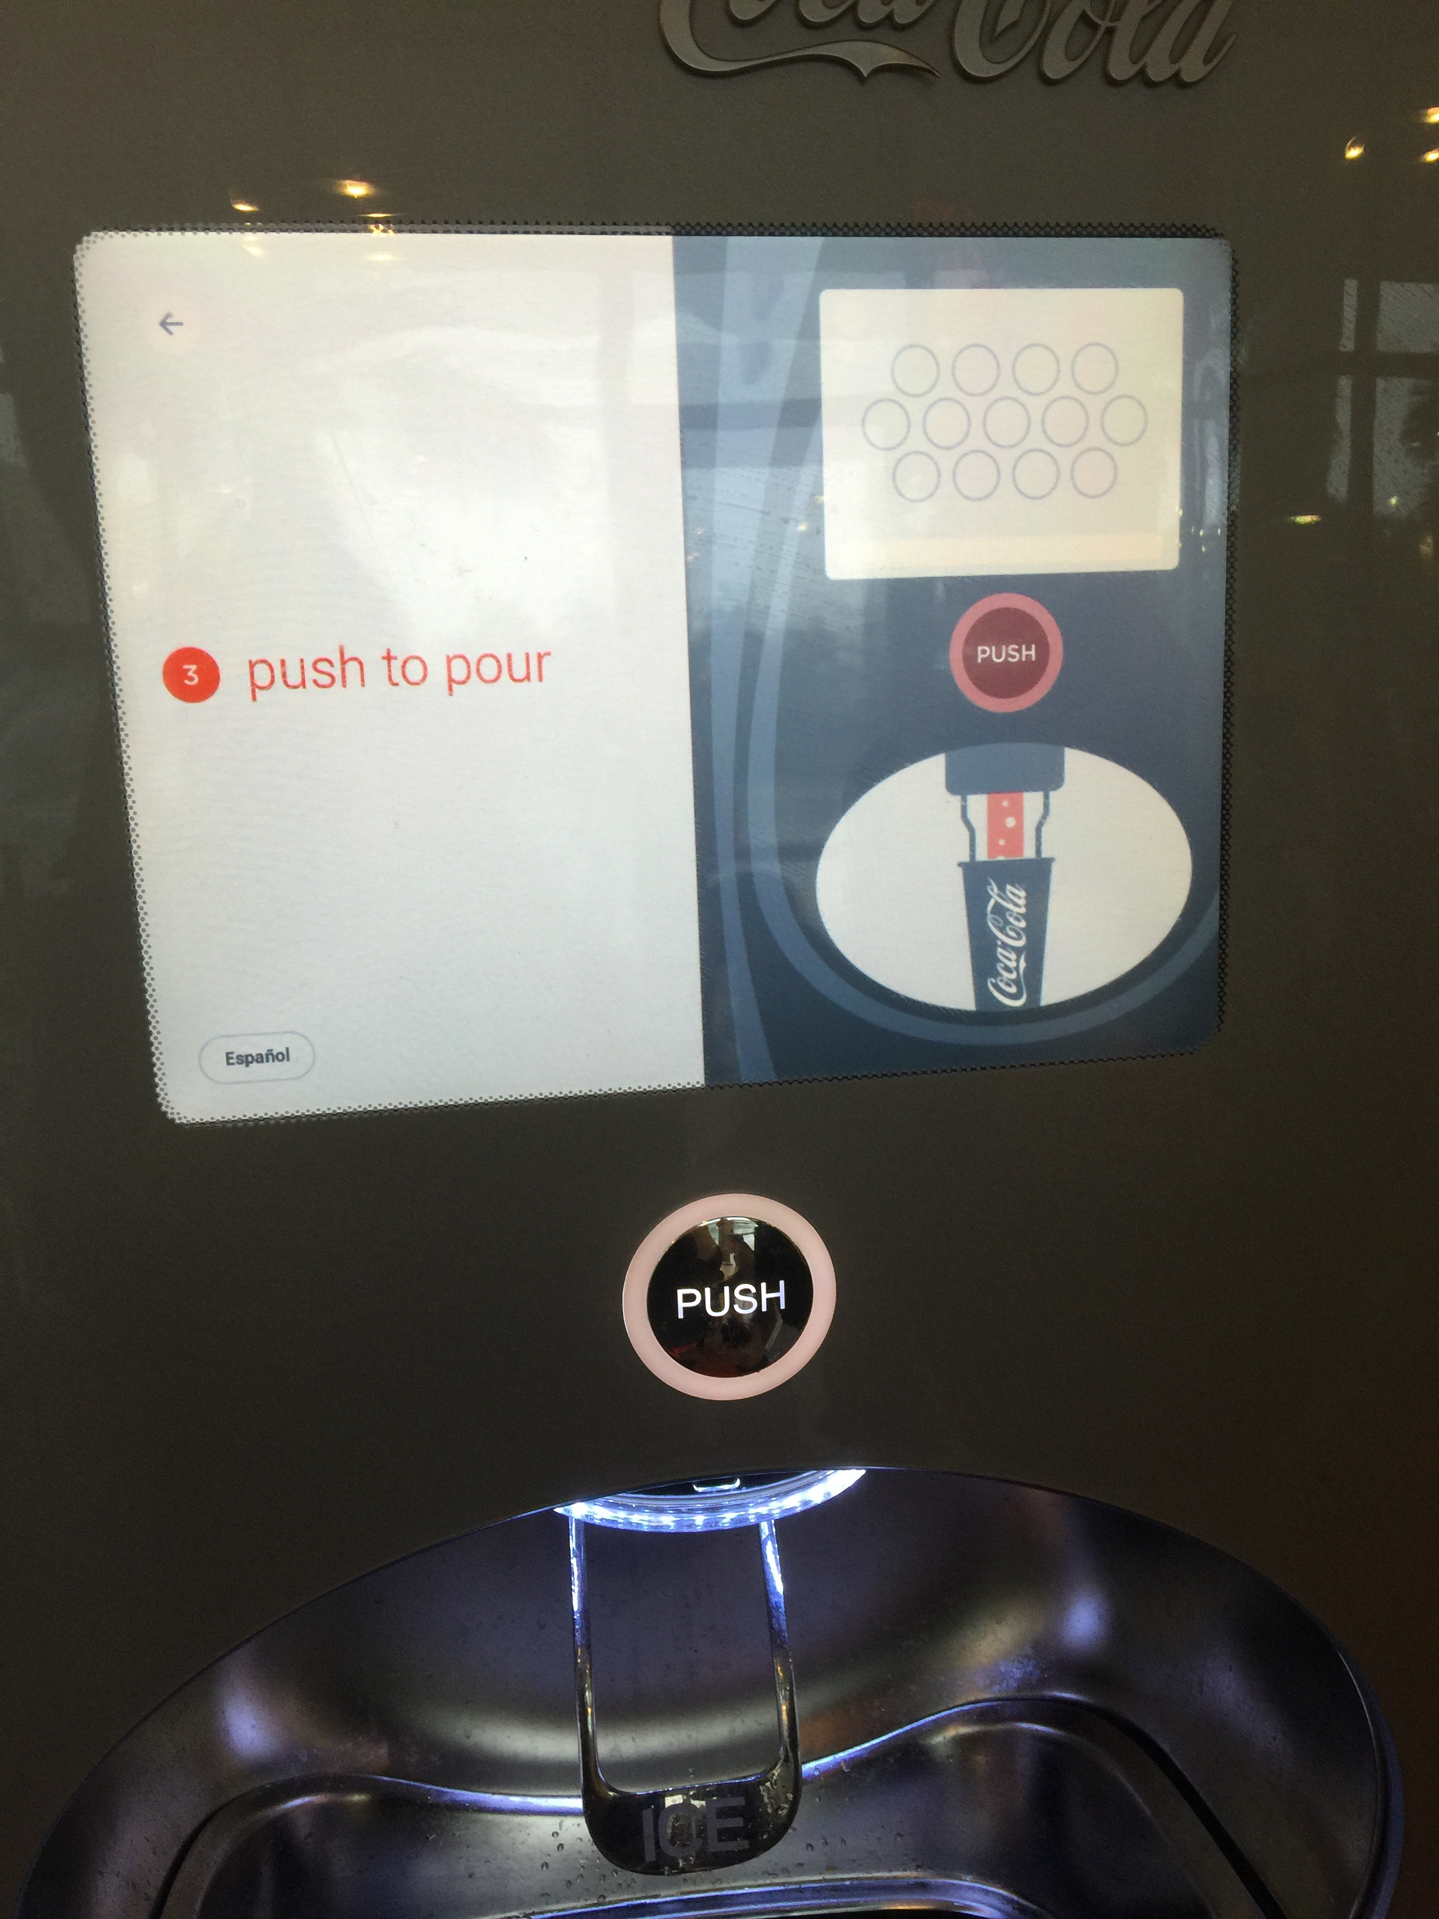
Findings: Other Problems *
Handicap buttons are not very responsive and don’t allow for simple navigation of the screen.
The help button provides instructions that are slow and difficult to follow
*Problems we noticed but did not observe

Slide 28
Recommended Redesign
Version 1 of machine Redesign
Interface Option #1
Interface Option #2

Slide 29
Recommended Redesign
The machine should have a separate button for water that is not on the screen in order to make the process of getting water faster. There should be an ice button next to the water button as users were not expecting to press on an ice lever.
There should be a barrier where the cup goes so the user can place the cup in the correct place and not spill liquid or ice over their hands.
There should be a QR code scanner rather than a QR code on the machine. The scanner should be next to the screen accompanied by a quick line about connecting your phone to the machine, so users are more aware it exists.

Slide 30
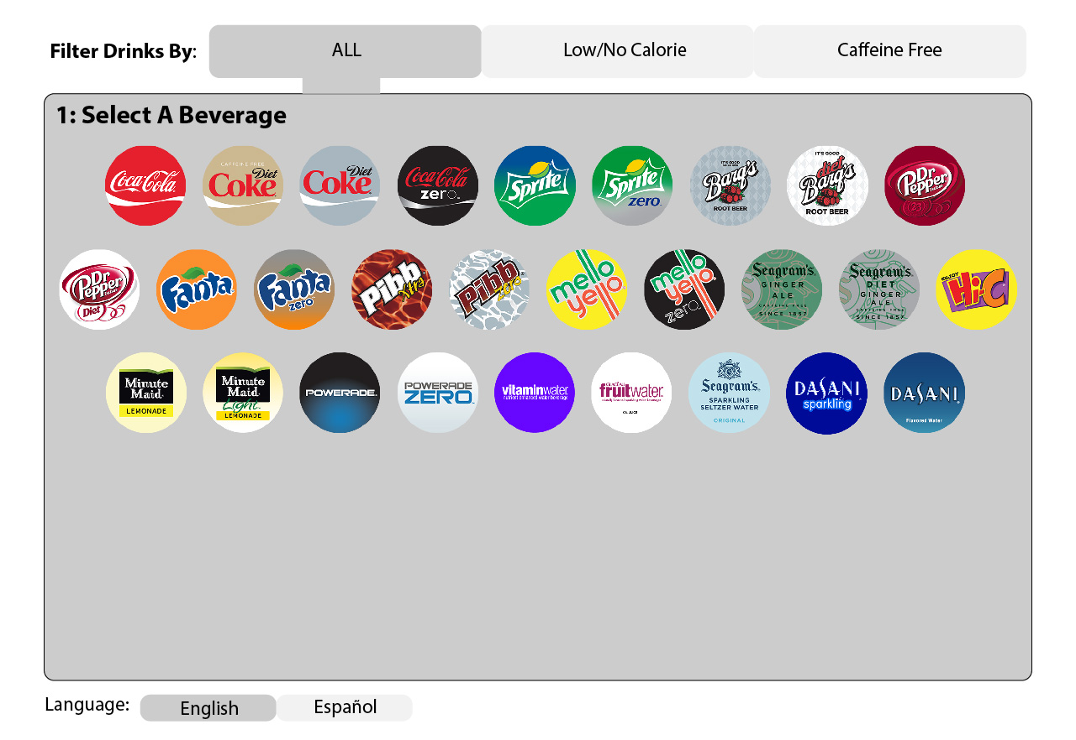
Recommended Redesign
1.
Initial Screen
User can use the filter to select a subset of drinks, currently the “ALL” is active
The user can see all of the drinks in the category
Language toggle
2.
3.

Slide 31
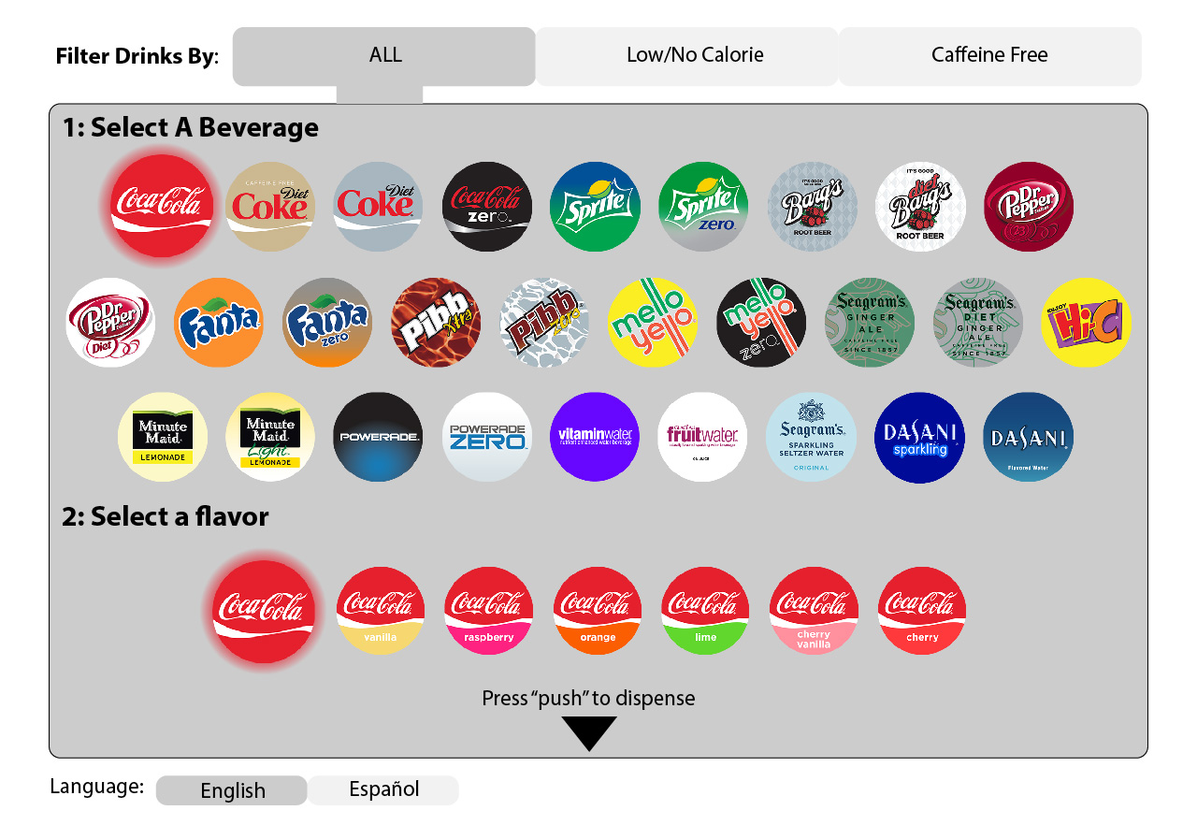
Recommended Redesign
When the user selects a beverage
When the user selects a beverage the button will expand and 2 becomes visible
Once the user choses a beverage the flavors will appear. The regular version with no flavor is selected by default so the user doesn’t have to select the drink a second time if they just want the plain beverage
1.
2.

Slide 32
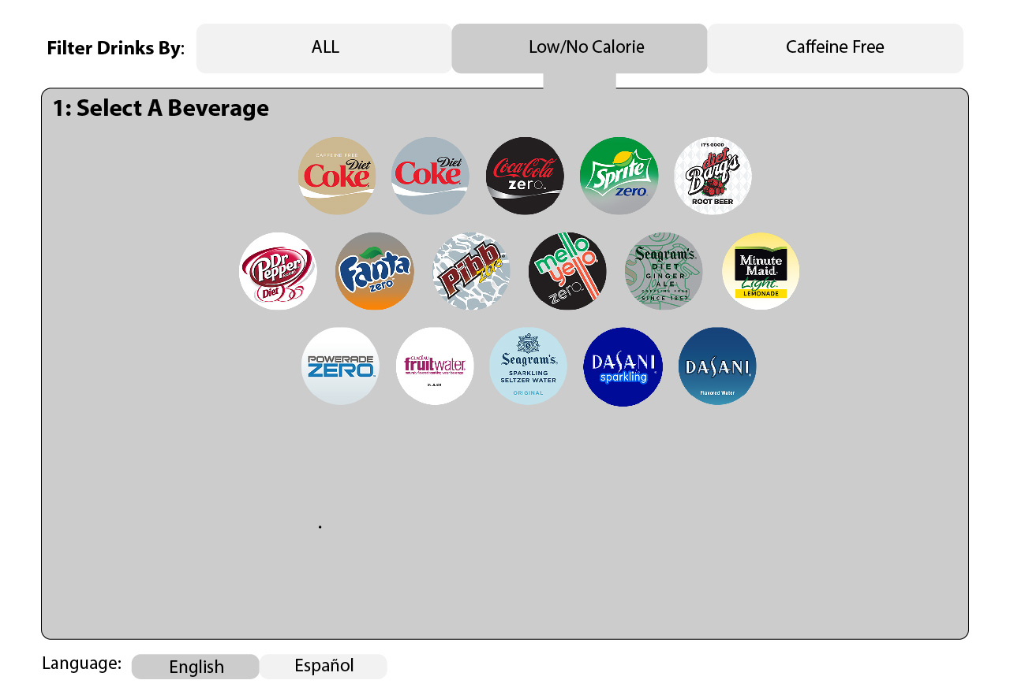
Recommended Redesign
When the user changes the filter
When the user selects another option in the filter at the top of the screen, they will see that subset of drinks
1.

